Slide 1
Dr. REHAN SABIR MOMIN Consultant Surgeon
Ca Colon

Slide 2
Anatomy
Extent : Ileocaecal valve to Anus
Length : 135 – 150 cms
5 segments : Right & Left Colon (fixed)
Transverse & Sigmoid Colon (mobile)
Anorectum
Alternate segments of Colon are mobile & fixed
Hepatic Flexure is Broad & Splenic Flexure is Acute (Ischemic Colitis commonly affects splenic flexure)

Slide 3
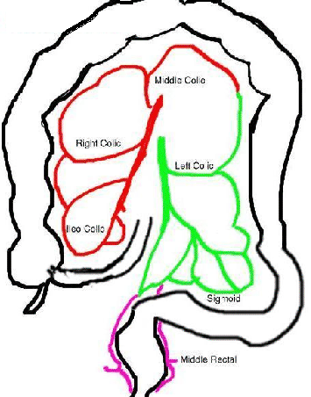
Blood Supply of Colon
Superior Mesenteric Artery (SMA)
i) Middle Colic Artery – Right & Left branches
ii) Right Colic Artery
iii) Ileocolic Artery
Inferior Mesenteric Artery (IMA)
i) Left Colic Artery
ii) 3 Sigmoidal Branches
iii) Superior Haemorrhoidal Artery

Slide 4
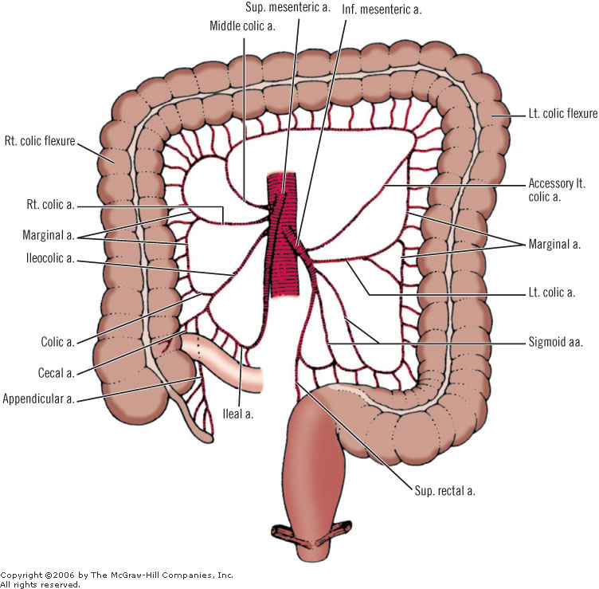
SMA & IMA

Slide 6
Why Cancer seen in Left Colon?
Mucosa of the distal colon is more exposed to carcinogens as a result of protein metabolism & putrefaction in left colon
50% of cancers arise in Left side & 25% of cancers are seen on Right side

Slide 7
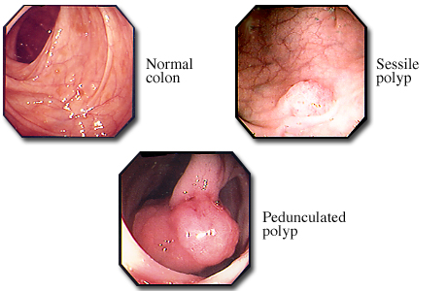
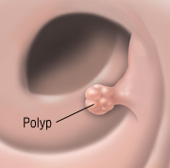
Benign Tumours of Colon
Adenomatous Polyp
Hamartomatous Polyp
Familial Adenomatous Polyposis (FAP)

Slide 8
Hereditary Colon Cancer
FAP
HNCC
Peutz Jeghers Syndrome
Juvenile Polyposis Syndrome

Slide 9
Familial Adenomatous Polyposis
It is a Genetic disorder, runs in families
Transmitted from both parents
Age commonly seen is 20 years
Clinically presents with Blood & Mucous in loose stools with Pain Abdomen
Incidence of Malignancy is 100%
Age of developing into carcinoma is 39 years

Slide 10
Familial Adenomatous Polyposis
When associated with Desmoid tumour, Craniofascial osteoma, Epidermoid cysts, Congenital hypertrophy of retinal epithelium it is called as Gardner’s Syndrome
When associated with CNS tumours & Glioblastoma it is called as Turcot’s Syndrome
Diagnosed by Sigmoido/Colonoscopy
Screening is advisable from age of 10 years by Sigmoidoscopy

Slide 11
Treatment of FAP
Surgery is Advisable even when polyp biopsy does not show malignancy
Subtotal Colectomy with Ileorectal anastomosis
Or
Restorative Proctocolectomy with ileoanal anastomosis using Pouch

Slide 12
Hereditary NonPolyposis Colorectal Cancer (HNPCC)
No Polyps
It has high incidence of synchronous & metachronous growth
Synchronous – developing multiple primary carcinoma in different parts of colon at the same time (5-10%)
Metachronous – developing growth in different parts of colon at different periods (10-20%)
Diagnostic Criteria :
Atleast 3 members in a family should have colorectal cancers, 2 of whom are 1st degree relatives
Atleast 2 consecutive generations
Atleast one relative should have colorectal cancer in <50 yrs of age

Slide 13
Carcinoma Colon
It is the second most common cause of cancer death
It is Adenocarcinoma
5 year survival rate is 37%
(5 year survival rate = Percentage of patients who live atleast for 5 years after their Cancer were diagnosed / treated)
37% of patients have detectable liver metastases
10% of patients develop lung metastases
5% of women patients will have macroscopic metastases due to transcoelomic spread, thats the reason colorectal surgeons do routine Oophorectomy in all women with colorectal cancer

Slide 14
Transcoelomic Spread
Cancer spread through the peritoneum either via subperitoneal lymphatics or cancer cells shed from serosal surface of primary tumour giving rise to malignant ascites

Slide 15
Precancerous Conditions
1. Polyps – Incidence of malignancy is increased when the polyp is :
>1cm
Polyps are multiple
Polyp is Flat
2. Longstanding Ulcerative Colitis
3. Familial Adenomatous Polyposis (FAP)

Slide 16
Etiology
1. SAD factors :-
S – Smoking
A - Alcohol
D – Dietary factors : Red meat & saturated fat / Lack of vegetables in diet increases incidence of colonic carcinoma
2. HNCC
3. Bile acids act as carcinogens. Secondary bile acid secretion is increased after cholecystectomy & ileal resections, therefore prone to develop carcinoma colon

Slide 17
Pathological Types
Annular stricture – seen in Splenic flexure, Left colon & Sigmoid colon
Tubular stricture – seen in Left colon & Rectosigmoid junction
Ulcerative – seen in Ascending colon or Caecum
Proliferative – seen in Right colon
Other way of Classification :
Right side Colon Left side Colon
Ulcerative Type Annular (stenosing) Type
Proliferative Type

Slide 18
Clinical Features
Age : > 50 years
Familial type presents in younger age
M:F = 3:2
Right side Ca Colon – presents with Anemia
Left side Ca Colon – presents with constipation, colicky abdominal pain & bleeding P/R
20% of patients have disseminated disease (stage IV) at time of presentation
20% of patients with Colonic Cancer will present as an Emergency in form of acute Intestinal Obstruction

Slide 19
Staging & Grading
Staging – clinical assessment of tumour
Grading – histopathological assessment of tumour

Slide 20
Staging
Dukes Staging for COLORECTAL cancer :
Based on Histological examination of resected specimen
A – Invasive carcinoma NOT breaching muscularis propria
B – Invasive carcinoma breaching muscularis propria, but NOT involving regional lymph nodes
C – Regional Lymph Nodes involved
D – Metastases
Note : carcinoma confined to muscularis mucosa does NOT metastasize

Slide 21
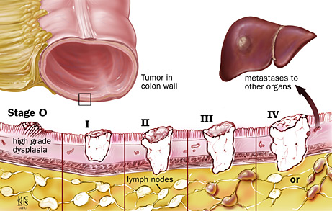
Duke’s staging for Colorectal Cancer

Slide 22
Pathological Staging
Pathological staging depends on following :
Size of tumour (greatest dimension)
Site of tumour
Histological type
Extent of invasion – submucosa, muscularis propria & extra mural
Serosal involvement
Number of Lymph Nodes
Vascular invasion

Slide 23
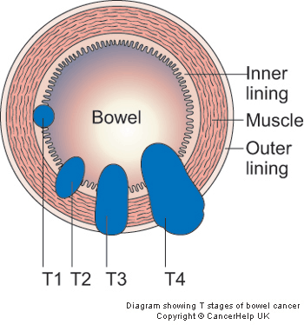
TNM classification for Colon Cancer
T – Tumour stage
T1 – Tumour invades into submucosa
T2 – Tumour invades into muscularis propria
T3 – Tumour invades through muscularis propria into
pericolic fat or sub-serosa but does NOT breach serosa
T4 – Breaches serosa (perforates visceral peritoneum) or
directly invades another organ
N – Nodal stage
N0 – No nodes involved
N1 – 1 to 3 nodes involved
N2 – four or more nodes involved
M – Metastases
M0 – No metastases
M1 – Distant Metastases

Slide 24
Investigation
Rigid Sigmoidoscopy to exclude rectal pathology
Colonoscopy + Biopsy
Water soluble contrast enema :
shows “apple core” stricture, if primary colonoscopy fails to achieve total colonic visualisation
USG
CEA (carcinoembryonic antigen)

Slide 25
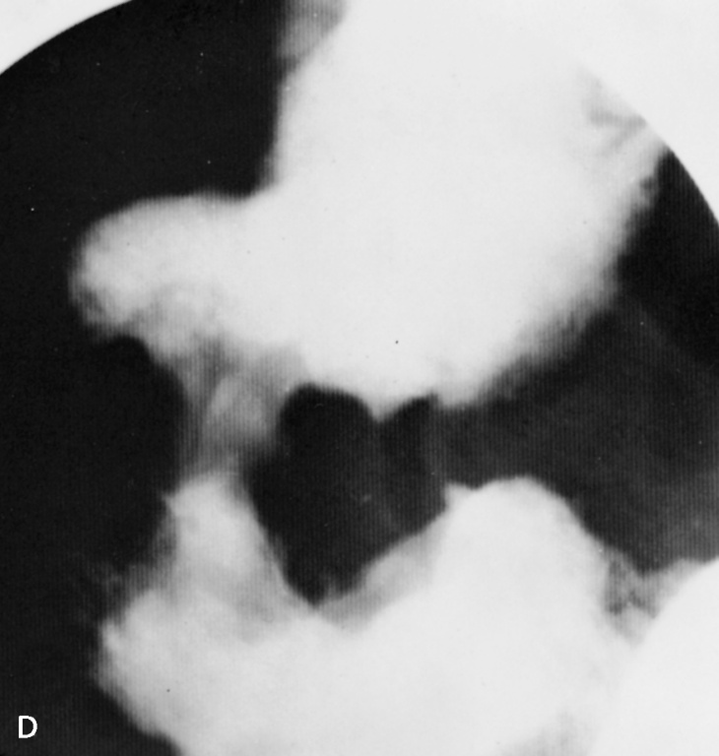
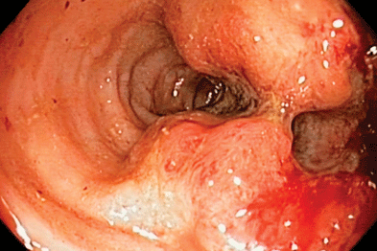
Investigations
Apple core lesion on Barium enema
Colon growth in colonoscopy

Slide 26
CEA
It is a Glycoprotein produced by colon epithelium
Its half life is 10 days
Normal levels < 2.5ng/ml
> 5ng/ml is significant
> 7.5ng/ml indicates poor prognosis
It has low sensitivity as a tumour marker
Can be used to diagnose in carcinoma pancreas, stomach, lung & breast
CEA levels also increases in Non cancerous conditions like Pancreatitis, Hepatitis, Obstructive Jaundice & BPH
Increase levels during post operative follow up indicates recurrence / secondaries

Slide 27
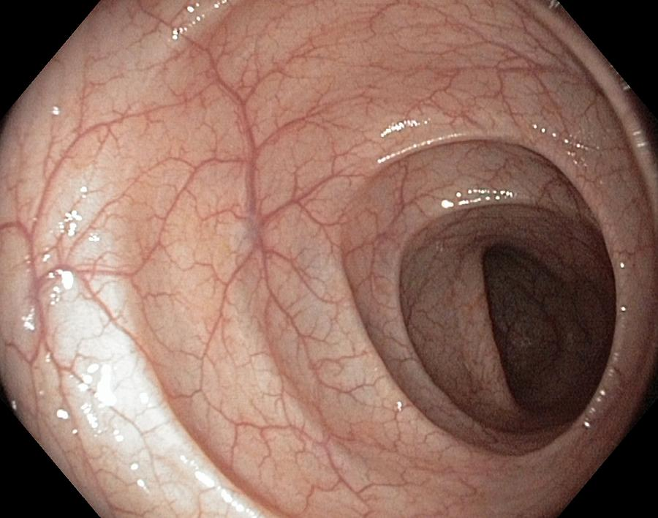
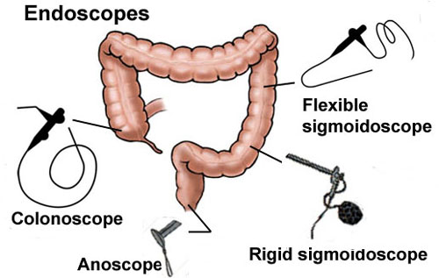
Investigation for Screening of Ca Colon
Fecal occult blood test : Annually > 50 years
Flexible Sigmoidoscopy : Once in 5 years > 50 yrs
Colonoscopy : Once in 5 years

Slide 28
Complication of Carcinoma Colon
Intestinal Obstruction
Closed loop obstruction :
Carcinoma in transverse colon with patent IC valve results in closed loop obstruction.
It presents with dilatation of caecum & stercoral ulcer over summit of caecum due to pressure ischemia.
Perforation
Pericolic Abscess
Vesicocolic Fistula
Invasion of Ureter

Slide 29
Management of Colon Cancer
Radical surgical excision of colonic tumour along with its vascular pedicle & lymphatic drainage
Adjuvant Chemotherapy
Adjuvant Radiotherapy

Slide 30
Principles of Surgery for Ca Colon
Midline incisions for all colonic resections
NOT to attempt pre-operative preparation in presence of obstruction
Bowel preparation is not responsible to prevent anastomotic leaks
Important criteria to achieve anastomosis are :
i) Good blood supply at cut ends of bowel
(brisk bleeding & good colour)
ii) Lack of tension over suture line - Anastomotic leaks are caused by technical error like poor knotting & tension sutures

Slide 31
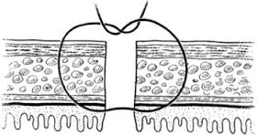
Principles of Surgery for Ca Colon
No Touch technique of Turnbull – Divide the vascular pedicle at the beginning of surgery to reduce chance of tumour embolism
Interrupted seromucosal method is choice to all colonic anastomoses
Colostomy stoma formation should be carried out in patient’s interests only & not as a result of lack of experienced surgical staff

Slide 32
Right sided Obstructed Lesion
Operable Tumour Inoperable Tumour
Standard Right Hemicolectomy ileocolic Bypass
Q what is difference between operable & resectable tumours?
Operable is patient dependent
Resectable is tumour dependent

Slide 33
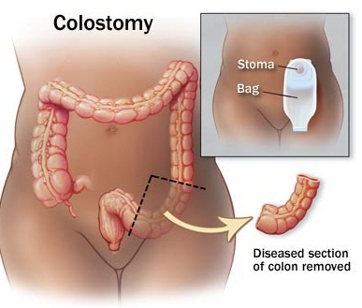
Left sided Obstructed Lesion
Operable Tumour Inoperable Tumour
Temporary Colostomy Defunctioning Colostomy
followed by Elective colonic resection

Slide 34
Left sided Obstructed Lesion
Surgical options for Left sided operable obstructive lesion :
A) 3 stage procedures :-
i) Defunctioning loop Colostomy
ii) Resection of obstructive lesions & colonic anastomosis
iii) Closure of defunctioning stoma
B) 2 stage procedures :-
i) Hartmann’s Operation – Primary resection of tumour with
colostomy
ii) Closure of End colostomy
C) 1 stage procedure :-
Subtotal colectomy with ileocolic/ileorectal anastomosis

Slide 35
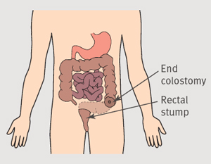
Hartmann’s Procedure

Slide 36
Extent of colonic resection in Carcinoma
Ca Caecum
Ca Ascending
Ca Hepatic flexure Right Hemicolectomy
Ca Transverse
Ca Splenic flexure
Ca Descending
Ca Sigmoid Left Hemicolectomy

Slide 37
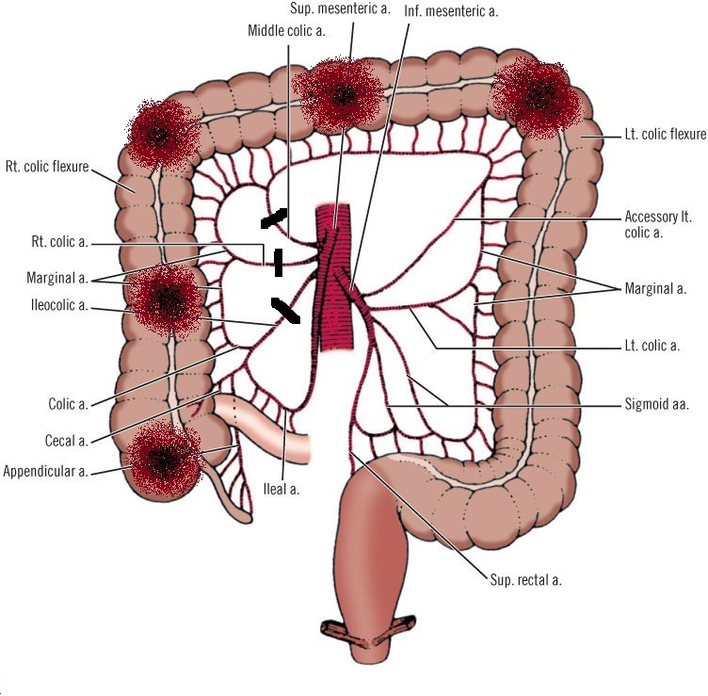
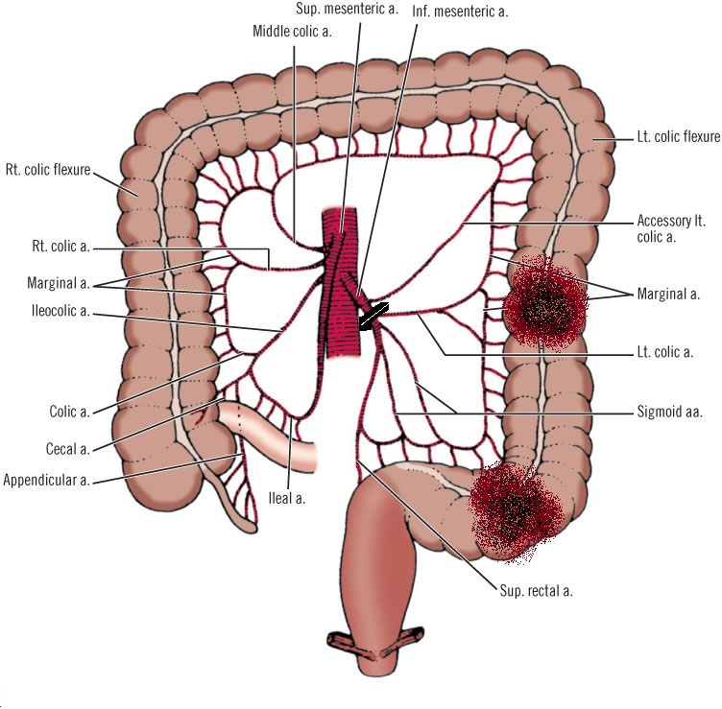
Rt Hemicolectomy Lt Hemicolectomy

Slide 38
Right Hemicolectomy
Division of ileocolic artery
Division of right colic artery at its origin from SMA
Division of right branch of middle colic artery
Removal of terminal 6cms of ileum

Slide 39
Right Hemicolectomy

Slide 40
Left Hemicolectomy
Division of IMA at its origin from Aorta

Slide 41
Caecal Lesion
On AXR, if caecum is 12 cms or more in diameter then urgent surgical intervention is required
On Laparotomy, check caecum :
i) If caecum is dilated – Obstruction in distal colon
ii) if caecum is collapsed – Obstruction in proximal
small bowel
Decompress gaseous distension of large bowel by inserting 19 gauge needle through taenia
Radical excision includes : 6cm ileum, caecum, appendix, ascending colon & part of transverse colon along with their lymphatics

Slide 42
Splenic Flexure lesion
Right Extended Hemicolectomy is the choice :
Ligate Right + Middle + Left colic artery
Anastomose Sigmoid colon to ileum
In 6% cases, there is NO Left colic artery & blood supply of splenic flexure is from middle colic artery
But in 22% cases middle colic artery is ABSENT & blood supply of splenic flexure is from both Lt + Rt colic arteries.
Splenic Flexure lesions have high local recurrence & poor survival rate regardless of stage & presentation.

Slide 43
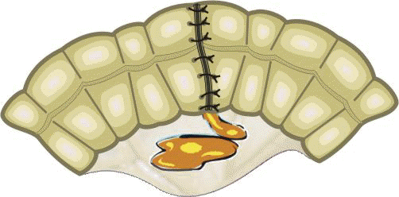
Transverse Colon lesion
Transverse colectomy is NOT done due to high anastomotic leaks

Slide 44
Outcome of Colonic Surgery
Operative mortality for emergency case is < 20%
Operative mortality for elective surgery is 5%
Wound infection rate is < 10%
Leak rate for colonic resection is < 4%

Slide 45
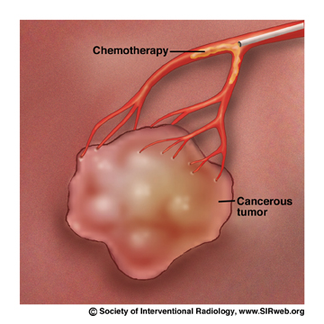
Indications of Adjuvant CT
Positive lymph nodes
T4 lesion
Venous spread
Signet cell type
Poorly differentiated tumour
CEA level increases postoperatively
CT drug of choice – 5FU + Folinic acid x 6 month
as a monthly cycle
(Folinic acid potentiates action of 5 Fluorouracil)

Slide 46
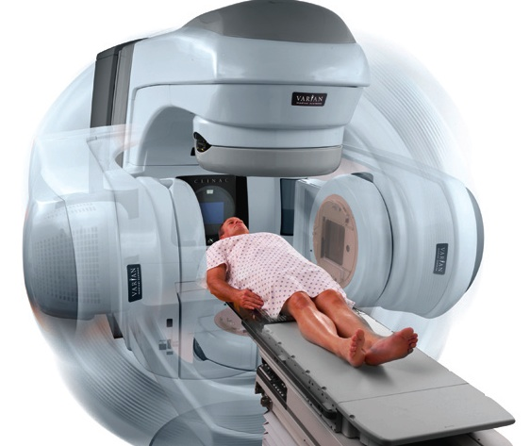
Radiotherapy in Ca Colon
NO role of radiotherapy as colon tumours are Radioresistant
It can be only used in inoperable recurrent tumours

Slide 47
Follow Up
Follow Up should be advised for 3 years
F/U visit should be done once in 3-6 months
Investigations advised during follow-up are :
i) CEA analysis
ii) USG abdomen
iii) Colonoscopy / Enema X rays
iv) Serum Alkaline Phosphatase

Slide 48
5 year survival rate
% of patients who live atleast for 5 years after their Cancer diagnosed
Stage I – 90%
Stage II – 75%
Stage III – 50%
Stage IV - < 5%

Slide 49
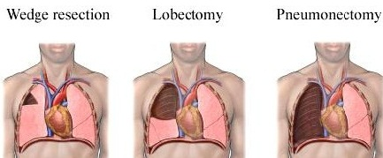
Operable Metastases
LIVER : Criteria for liver resection is 1-3 resectable metastases in one lobe of liver
Five year survival with Hepatectomy for colorectal metastases is 30%
LUNG : Only 10% of patient develop lung metastases
Five year survival with segmental lung resection is 20-40%

Slide 50
Prognosis
Good Prognosis Bad Prognosis
Left side tumours have - Colloid Ca
better prognosis as they - Liver metastases
present early

Slide 51
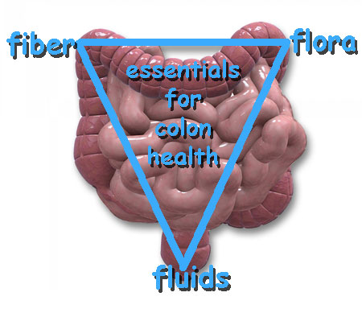
“Prevention” is better than Cure

Slide 52
THANK YOU

