Slide 1
Dr Rehan Sabir Momin
Rectal Cancer

Slide 2
Definition of Rectum tumour
Rectum begins where the two antemesenteric taenia on sigmoid colon fuse together. It is at the level of sacral promontory 15 cms from Anus
Ca Rectum is defined as tumour within 15cms of anal verge on rigid sigmoidoscopy
Tumours with a distal margin at 15cms or less from anal verge is defined as Rectal tumours

Slide 3
Incidence
Commonly seen in Females
Develops from a pre-existing adenomas
In 3% of cases it occurs at multiple sites (synchronous)

Slide 4
Predisposing Factors & Pre cancerous Lesions
Smoking
Alcohol
Low Fiber diet
Familial Adenomatous Polyposis (FAP)
Rectal Polyps Eg: Villous adenoma
HNPCC – Hereditary Non Polyposis Colon Cancer
Ulcerative Colitis / Crohn’s Disease
Family History of Rectal cancer

Slide 5
Rectal Polyps
Villous Adenomas
FAP
Hyperplastic Polyps
Inflammatory Polyps
Juvenile Poly (Cherry Tumour)

Slide 6
Villous Adenoma
Rectum along with Sigmoid Colon is most frequent site of Polyps in GI tract
Villous adenoma are huge polyps in rectum filling the entire rectal lumen
Adenomatous Polyp have potential to become malignant which can be detected on P/R Examination by feeling ‘Hard’ area
Note: Any hard area in anorectal region should be assumed to be malignant & should be biopsed
Due to huge size of villous adenomas, profuse mucous discharge from these tumours which are rich in potassium results in ‘Hypokalemia’

Slide 7
Villous Adenoma
Treatment :
Removal of all polyps is recommended to rule out carcinoma by histopathological examination
Note: No Rectal Polyp should be removed until the proximal carcinoma has been ruled out, otherwise local implantation of cancer cells may occur in distal rectal wounds
Submucosal resection of these tumours endoscopically done by a technique called Transanal Endoscopic Microsurgery (TEM)

Slide 8
Pathology of Rectal Ca
Rectal carcinoma commonly presents as an Ulcer but polypoidal & infiltrating types are also seen
Annular growth at rectosigmoid junction encircles the lumen in 12 months
Histologically, it is Adenocarcinoma, which is classified as: Well-Differentiated = 10%
Moderately Differentiated = 65%
Undifferentiated = 25%

Slide 9
Spread of Rectal Ca
Local Spread :
Intraluminal, spreads Circumferentially rather than longitudinally (it takes 12-18 months to complete the circumference of the bowel)
Anteriorly, spread to prostate, bladder, seminal vesicles in Males & Uterus Vagina in Females
Posteriorly, invades sacrum & sacral nerve plexus
Laterally, spreads into Ureters

Slide 10
Spread of Rectal Ca
Lymphatic Spread:
Occurs in upward direction following the blood supply and drains into Para Aortic Lymph nodes. Therefore, radical surgical operation should ensure the removal of high level lymph nodes by ligating IMA at higher level.
Venous Spread :
Metastases to Liver (35%) & Lung (20%)
Transperitoneal spread
Perineural spread : carries poor prognosis

Slide 11
Duke’s staging Prognosis
A – Growth confined to rectal wall - 90% (good)
(mucosa + submucosa)
B – Growth spread to extrarectal
tissue but No LN metastases - 70%
C – LN metastases present - 40% (poor)
D – Hepatic metastasis

Slide 12
TNM staging of Rectal Carcinoma
Internationally recognized staging system
T1 – Invasion of muscularis mucosa
T2 – Invasion of muscularis propria
T3 – Invasion of serosa
T4 - Invasion of adjacent organs & other tissues
No – No Lymph nodes spread
N1 – 1 to 3 lymph nodes
N2 – 4 and more lymph nodes
Mo – No distant metastasis
M1 – Distant metastasis to Liver, Lungs

Slide 13
Grading
Grade Histological type Prognosis
Low Well differentiated Good
Average Moderately differentiated Fair
High Undifferentiated Poor

Slide 14
Clinical features
Bleeding P/R – occurs at the end of defeacation
Tenesmus – strains to empty bowels but does not evacuate any stools
Early morning bloody diarrhoea – overnight accumulation of mucous in ampulla of rectum causes urgency to defecate in morning
Constipation occurs in annular type of carcinoma near rectosigmoid junction
Pain in Back due to invasion of sacral plexus
Loss of weight & appetite due to distant metastases

Slide 15
Examination
On DRE: Rectal growth can be felt as nodule with induration
Note : 90% of rectal growth can be felt by P/R Examination
On Bimanual examination : Lower border of carcinoma situated at rectosigmoid junction can be felt by bimanual examination
Never insult the vagina by examining the rectum first

Slide 16
Indications of P/R examination
To palpate anorectal growth or polyp
To assess internal sphincter muscle tone
To assess Anal stenosis
To palpate Prostate in BPH
To palpate secondaries in rectovesical pouch
To confirm pelvic abscess
To feel papillae / internal opening in Fistula in ano
For bimanual palpation of pelvic tumours
In all acute abdominal conditions as a protocol
Contraindicated in Acute Fissure in Ano

Slide 17
Investigations
Investigations to CONFIRM the malignancy
Sigmoidoscopy with Biopsy
Colonoscopy to exclude synchronous tumours
If Colonoscopy not possible, then
CT Colonography
or
Barium enema
CEA (tumour marker)

Slide 18
Investigations
Investigations for STAGING of the tumour :
CT chest & Abdomen for distant metastases
MRI pelvis – helps to assess circumferential resection margin & adjacent structures
EUS – Endorectal Ultrasonography gives more accuracy of primary tumours, perirectal tissues & nodes. Its accuracy is 95% compared to MRI (85%) & CT (75%). It can detect lymph nodes upto 5mm in size

Slide 19
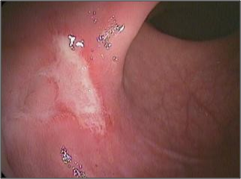
Differential Diagnosis
Proctitis
Solitary Rectal Ulcer Syndrome (SRUS)
Inflammatory Stricture
Amoebic granuloma
Tuberculosis
Carcinoid

Slide 20
Solitary Rectal Ulcer Syndrome (SRUS)
It is a single ulcer found in anterior wall of rectum
In 30% cases, there are multiple ulcers
This ulcer is formed due to chronic ischemia as a result of increased intrarectal pressure
C/F : Common in young patients with Chronic constipation, Bleeding P/R, mucosal prolapse & pain at defecation
On P/R Examination : Internal sphincter are normal tone

Slide 21
Solitary Rectal Ulcer Syndrome (SRUS)
Investigations :
Colonoscopy with Biopsy confirms the diagnosis
Defaecography shows non relaxing puborectalis muscle
Colonic transit time tells delayed clearance of stools from rectum
Treatment :
It is benign but difficult to treat
Manage conservatively by High Fiber diet
Prevent internal prolapse by Biofeedback
Try to avoid surgery as much as possible in SRUS

Slide 22
Management of Rectal carcinoma
Radical Surgical Excision
Radiotherapy
Chemotherapy

Slide 23
Surgical Options
Upper 1/3rd rectal ca – High anterior resection
No defunctioning colostomy
Middle 1/3rd rectal ca – Anterior resection with TME
temporary protecting colostomy for
colorectal anastomsosis
Lower 1/3rd rectal ca – AR + TME + Temporary colostomy –
Indicated only if lower margin of rectal
tumour is >2cms above anal canal
- APR + TME + Permanent colostomy –
Indicated if lower margin of rectal tumour
is <2cm above anal canal

Slide 24
List of Operations for Rectal Ca
Anterior Resection
Abdominoperineal Resection (APR)
Hartmann’s Operation
Pelvic Evisceration (Brunschwig’s Operation)
Palliative Colostomy

Slide 25
Anterior Resection
Sphincter saving procedure
Indicated for Upper & middle rectal growths
Low anterior resection (LAR) – resection of rectum & sigmoid colon below level of peritoneal reflection along with TME & colorectal anastomosis
Criteria for LAR :
Upper & middle rectal growth
Well differentiated tumour
Less than 4cm size tumour – T1N0 / T2N0
Tumour without Lymphatic or Venous spread

Slide 26
Abdominoperineal Resection (APR)
Criteria for APR :
Lower third of rectum or anus
Mesorectum involved
Poorly differentiated tumour
Regional lymph nodes are involved
Procedure : Left Colon & entire rectum is mobilised through abdomen & anal canal & perirectal tissue is dissected through perineum. Remnant proximal colon is brought out by end colostomy in LIF

Slide 27
Types of APR
Miles – abdomen first & perineum later
Gabriel – perineum first & abdomen later
Lioyd Davis – both simultaneously done by two
operating surgeons
Complications of APR :
Infection of perineal wound
Injury to sacral plexus
Colostomy complications – prolapse / stenosis

Slide 28
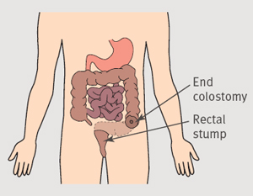
Hartmann’s Operation
It is a Palliative procedure for inoperable patients and locally advanced rectal tumours
After rectal tumour is resected, remnant rectal stump is left inside the pelvis & permanent end colostomy is done

Slide 29
Pre Op preparation
Counselling with stoma therapist to choose the site of stoma
Explanation of Complication of surgery – Risks of pelvic autonomic nerve damage resulting in bladder & sexual disturbance
Correction of anaemia & electrolyte disturbance
Arrange for Blood transfusion
Bowel preparation
Urethra catheterisation
Prophylactic Antibiotics

Slide 30
Important Terminology
Height of Tumour – It is the height of lower border of tumour from anal verge
Distal clearance margin – Sufficient margin below the tumour & above dentate line when right angled clamp can be applied defines the tumour free margin
High ligation of IMA – Divide flush on Aorta
Low ligation of IMA – Divide at level of sacral promontory

Slide 31
Denonvillier’s Fascia – Applied anatomy
It is a membranous partition that separates the prostate & urinary bladder from the rectum.
It consists of a single fibromuscular structure with several layers that are fused together called Denonvilliers' fascia after French anatomist & surgeon Denonvilliers.
The structure corresponds to the rectovaginal fascia in the female & rectovesical fascia in male
Denonvillier’s fascia acts as a barrier to tumour penetration
In posterior situated rectal tumour, early division of Denonvillier’s fascia will protect pre-sacral nerves which are responsible for erection & ejaculation in males

Slide 32
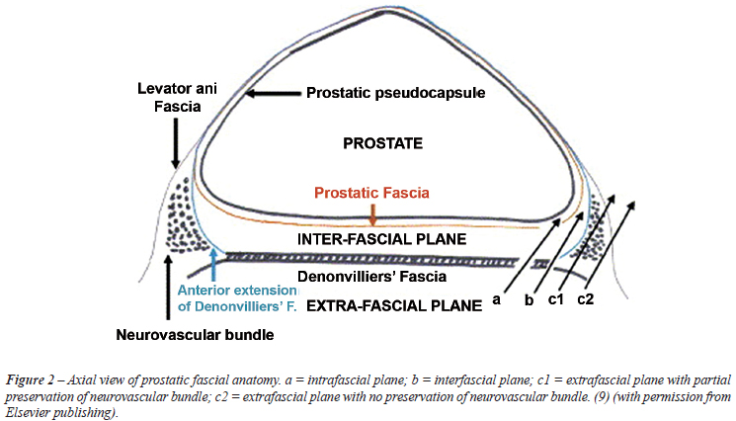
Denonvillier’s Fascia – Applied anatomy

Slide 33
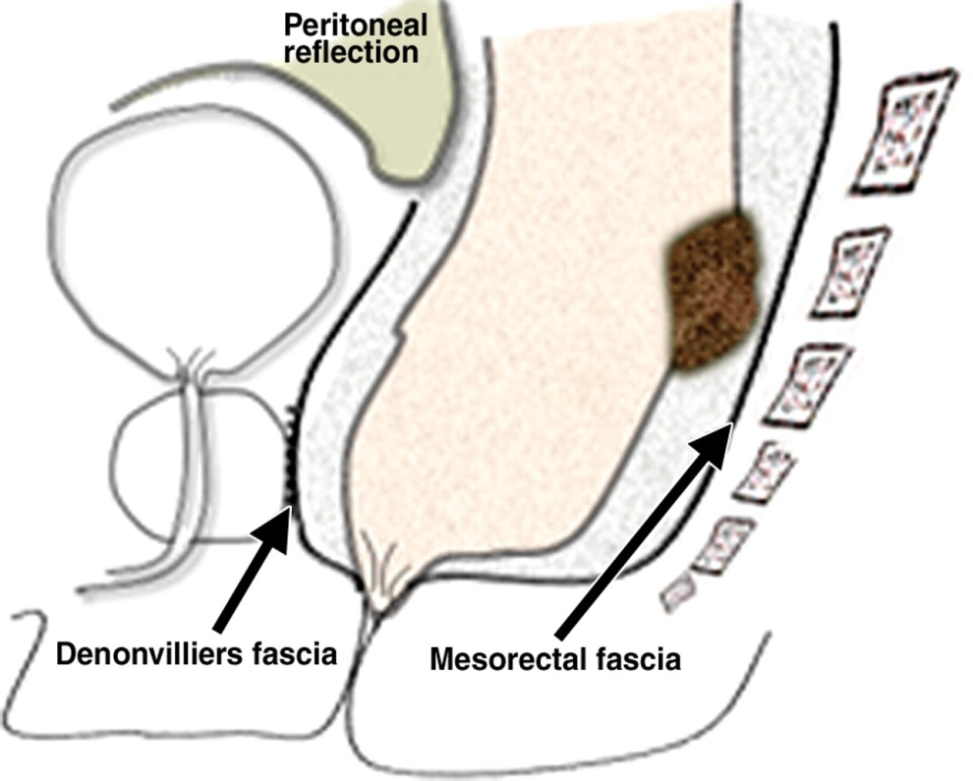
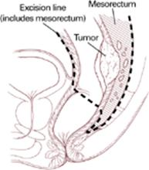
Mesorectum – Applied anatomy
It is the mesentery supporting the rectum
Fold of peritoneum connecting the upper portion of the rectum with the sacrum

Slide 34
Total Mesorectal Excision (TME)
In Rectal cancer surgery, TME is a radical operation like MRM for Breast cancer
It is a sharp dissection in avascular plane between visceral rectal fascia & parietal pelvic wall fascia
TME should be the goal in all procedures as mesorectum contains lymphatics & LNs which needs to be cleared
Mesorectum should not be breached
Both anterior layers of Denonvillier’s fascia should be dissected off to have tumour free clearance

Slide 35
Total Mesorectal Excision (TME)
In Upper rectal cancer, TME is not required
In middle & lower rectal tumours, Mesorectal clearance is done 5 cms below the lower margin of tumour
TME has reduced local recurrence rate
If TME is done successfully, then there is no benefit of doing extended pelvic lymphadenectomy
TME improves the quality of life with preservation of sexual & urinary functions

Slide 36
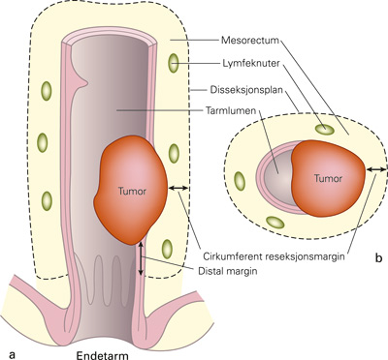
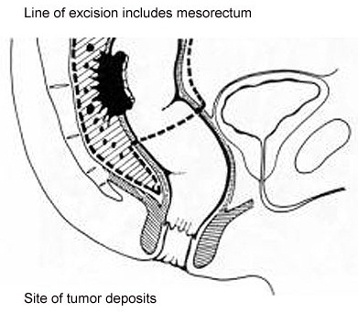
Total Mesorectal Excision
Mesorectal circumferential clearance

Slide 37
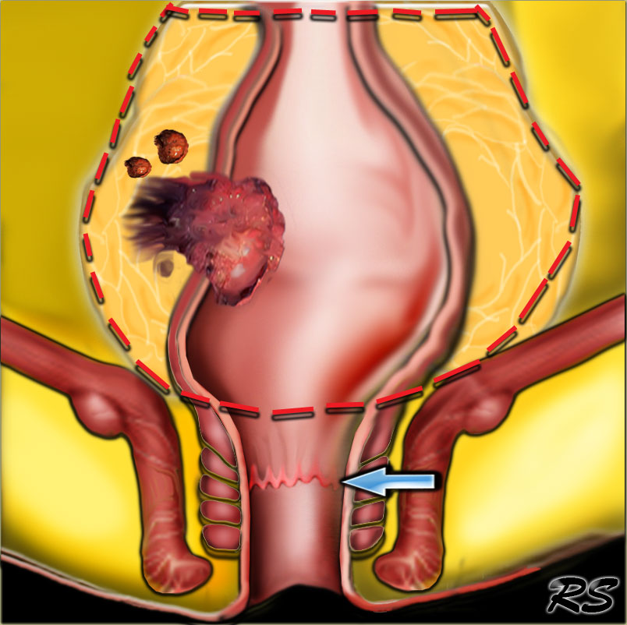
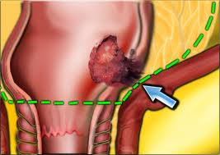
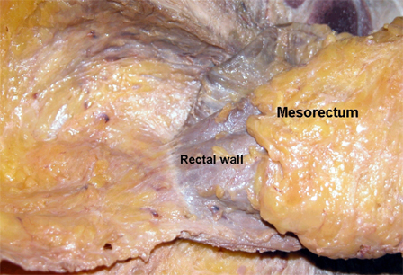
Total Mesorectal Excision
TME

Slide 38
Principles in Rectal Cancer Surgery
Adequate lymphatic & vascular clearance
Descending colon should be used in preference to sigmoid colon for anastomosing to anus. Descending colon will not reach the anus unless splenic flexure is mobilised which is achieved by High ligation of IMA
En bloc radical resection of primary tumour
Non touch technique
Circumferential resected margin (mesorectum clearance) should be atleast 5cms from primary tumour as tumour cell implants can occur upto 4cms distance from primary lesion

Slide 39
Principles in Rectal Cancer Surgery
TME should be done
Neoadjuvant chemoradiation is used for T3 lesion which can shrink the tumour & thus avoid APR
Local wide excision is preferred for tumour <4cms – T1N0 / T2No
In females, partial vaginectomy with hysterectomy & bilateral oophorectomy may be needed in T4 tumours

Slide 40
Griffith’s Point – Applied anatomy
It is a blood supply of splenic flexure by marginal artery which is supported by two terminal branches of Left colic artery
Surgical Importance of Griffith’s Point :
When mobilising the splenic flexure which is required for low coloanal anastomosis, it is important NOT to divide these two terminal branches of Left Colic artery, instead divide the main trunk of left Colic artery

Slide 41
Chemotherapy
CT is more effective if given perioperatively & immediate postoperatively till 1st week
CT is less effective if given after 7th Post Op day
5 Fluorouracil & Leucovorin is more effective than giving 5-FU alone
Folinic acid is added to 5-FU to double the response rate in advanced colorectal cancer
Chemoradiation is useful only in recurrent cases
5 year survival rate for rectal ca by surgery alone is 35%
5 year survival rate for rectal ca by surgery & Chemotherapy is 60%

Slide 42
Radiotherapy
In whole GIT, only rectal ca responds well for RT
It is useful when the growth is below level of peritoneal reflection
Pre Op RT is given to down stage the tumour so as to make it resectable for AR/APR
Postoperative RT is also recommended
Palliative RT is given for non resectable tumours
No role of RT for Lymph nodes metastasis

Slide 43
Lymph node Metastases
Pedunculated Polyps – No risk of LN involvement
Sessile Polyp – 10% chance of LN metastases
Tumour confined to bowel wall – 20% LN mets
Tumour penetrating bowel wall – 40% LN mets
Well differentiated tumour – 25% LN metstases
Poorly differentiated tumour – 50% LN metastases

Slide 44
Hepatic Metastases
Occult metastases within liver is responsible for death in next five years
Occult hepatic metastases kills the patient irrespective of surgical excision of rectal tumours
50% of patients with Colorectal cancer will eventually develop liver metastasis

Slide 45
Follow Up
TWO issues need to be looked for during follow up :-
i) Was a synchronous tumour missed during
preoperative work up?
Answer : 1st Follow Up should be done at 3 months
after resection by Colonoscopy.
ii) How should metachronous tumour should be looked
for?
Answer : By screening Colonoscopy once in 5 years
from 50 years to 75 years of age.

Slide 46
Recurrence of Tumour
Causes :
i) Primary tumour was disrupted at time of original operation which can be avoided by maintaining the integrity of mesorectal envelope
ii) Local excision was inadequate
iii)Viable exfoliated cells have implanted into wound

Slide 47
Recurrence of Tumour
Incidence of local recurrence rate is 30%
80% of local recurrence occurs within 2 years of operation
Common site of recurrence is in Pelvic wall
Evaluated by CEA, Biopsy, CT/MRI Pelvis & Abd
Difficult to manage

Slide 48
5 years survival rate
Stage A : 90 - 100%
Stage B : 50 - 80%
Stage C : < 50%

Slide 49
Thank You

