Slide 1
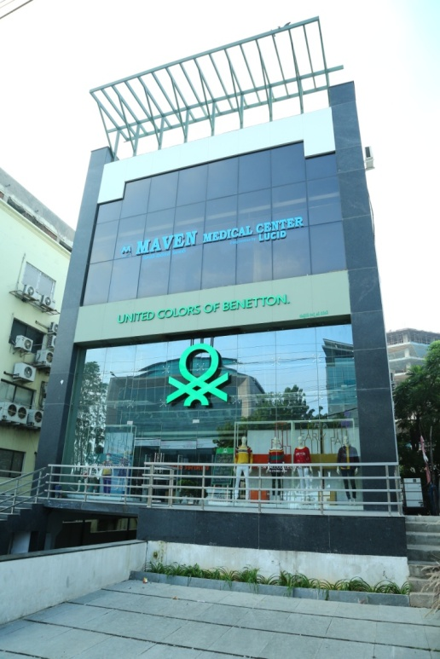
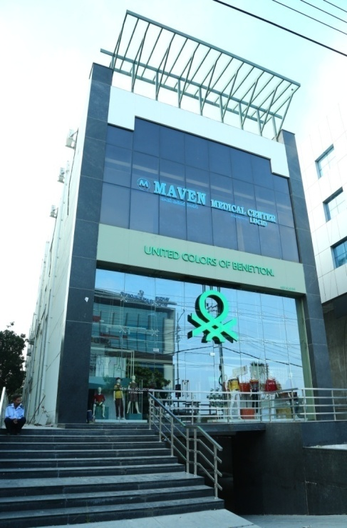
Recent Trends in Proctology
Professor
Dr REHAN SABIR MOMIN
MBBS, MS (General Surgery), FAIS, FICS (USA)
FICSP (Coloproctology), FIAGES (Laparoscopy)
Colorectal Surgeon

Slide 2
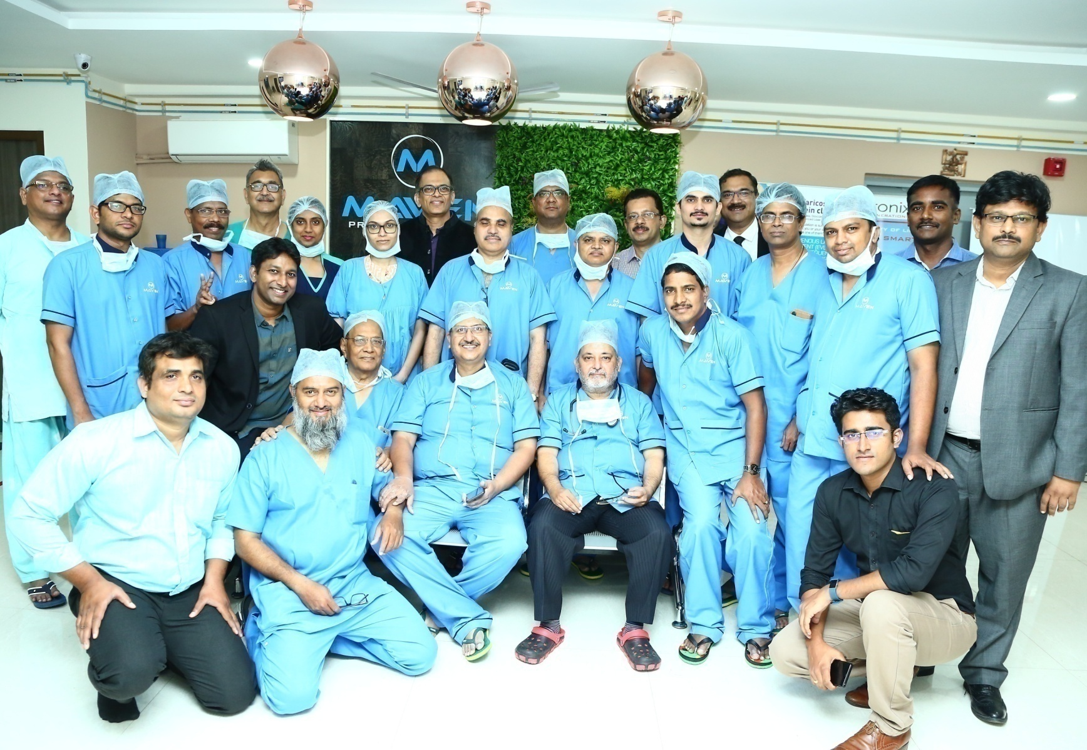
GREETINGs from MAVEN MEDICAL CENTRE

Slide 3
Purpose of this presentation
To bring awareness of the new modalities of surgery available to treat benign anorectal diseases.
To get awareness of advantages & limitations of these new surgical modalities.
(Note: This awareness should be shared among the doctors in general as well as patients effected by anorectal problems)

Slide 4
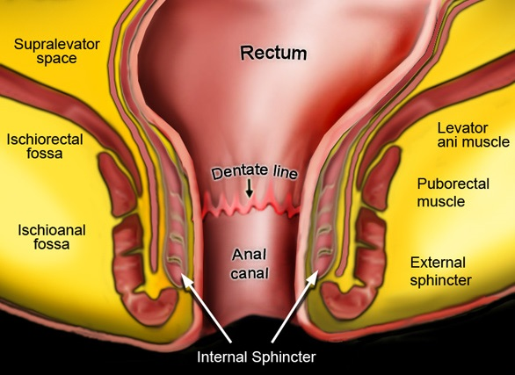
Proctology Surgical Practice
Haemorrhoids
Fissure in Ano
Anal Fistula
Pilonidal Sinus

Slide 5
Old Methods
Haemorrhoids – Haemorrhoidectomy
(Open/Close)
Fissure in Ano – Lateral Internal Sphincterotomy
(Open/Close)
Fistula in Ano – Fistulotomy / Fistulectomy
Pilonidal Sinus – Deep Excision of Tract

Slide 6
Newer Methods
For Haemorrhoids :-
- Haemorrhoidolysis using Ultroid
- Haemorrhoidopexy using HAL-RAR / Staplers
- Haemorrhoidplasty using Laser
For Acute Fissure in Ano :-
- Chemical Sphincterotomy using Inj Botox
For Fistula in Ano :-
Coring of tract using Fistulotome (Fixcision device)
Laser Ablation of tract using Diode Laser
For Pilonidal Sinus :-
- Laser Ablation of sinus cavity using Diode Laser

Slide 7
Misconception about Proctology
Surgical Treatment in Proctological diseases are very painful for the patients,
Proctology practice is no longer a painful experience for patients as it results in less pain due to minimal invasive procedures.
2) After Surgery Patient has to take bed rest for many days,
Since the innovations have taken place in instrumentations & newer techniques, proctology can be practised as a “Daycare” subspeciality & with minimum discomfort to the patients.

Slide 8
Proctology Set up
Proctology can be successfully practised as a “Daycare Stand Alone” set up or Daycare Clinic attached to any regular hospital.
Surgical Proctology practised as Daycare is catching up with a speciality name as
Minimal Invasive Proctology (MIP)
or
Laser Assisted Proctology (LAP)

Slide 9
Anatomy of Anorectal Region
1. Anal canal – 4cms
2. Internal anal sphincters – Involuntary muscle
3. External anal sphincters – Voluntary muscle
4. Intersphincteric plane contains 8-12 Apocrine glands which cause infection/pus
5. Anal glands present in crypts of Morgagni (Anal crypts) which open posteriorly
(Infection of these anal glands is common cause of anorectal abscess)

Slide 10
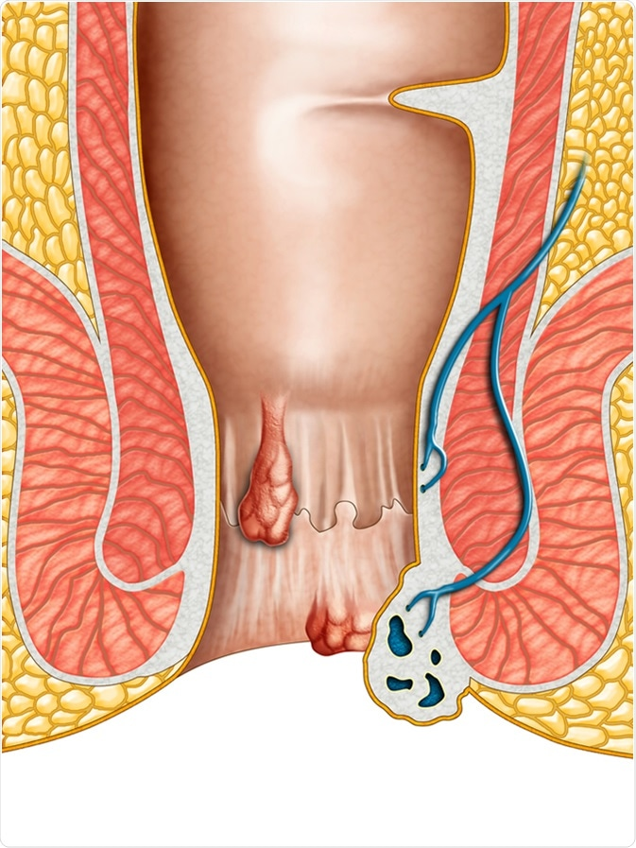
HAEMORRHOID

Slide 11
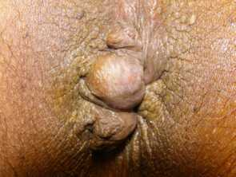
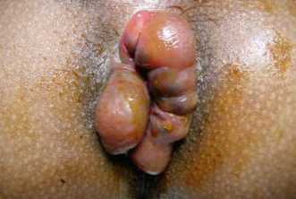
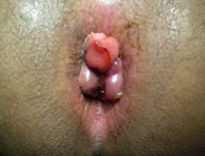
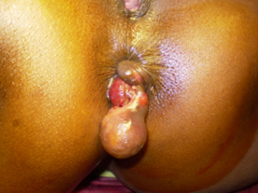
Hemorrhoids

Slide 12
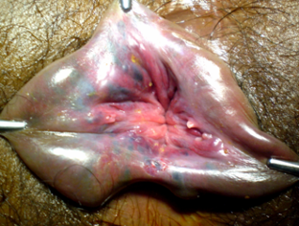
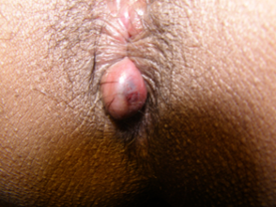
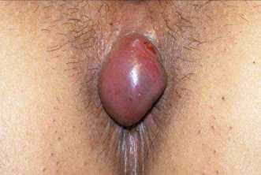
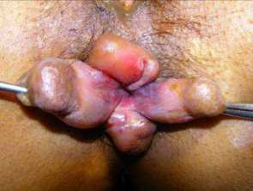
Hemorrhoids

Slide 13
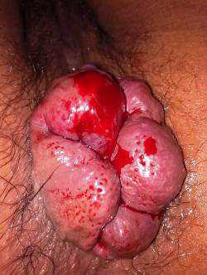
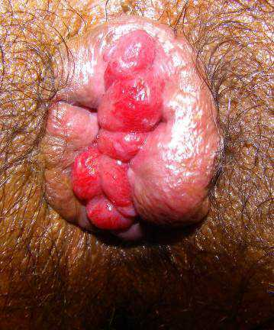
External Haemorrhoids

Slide 14
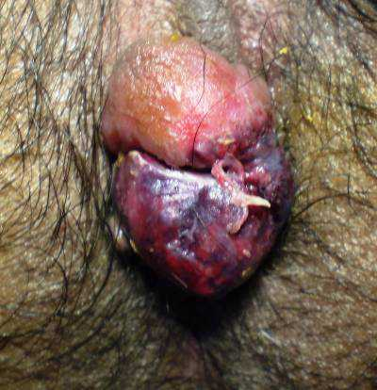
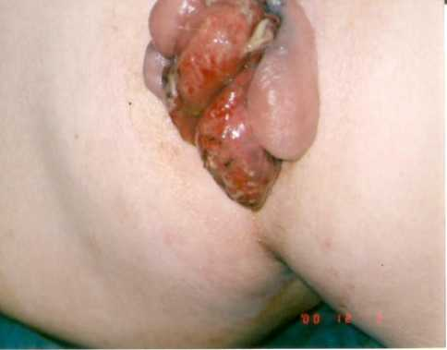
Thrombosed Pile
(Perianal Haematoma)

Slide 15
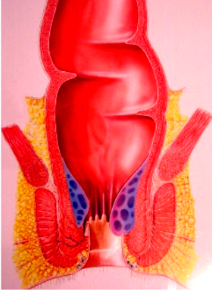
What are Haemorrhoids?
Haemorrhoids are slided cushions of tissue that line the anal canal.
Fate of Piles (what all can happen to a pile) :-
Anaemia
Prolapse
Thrombosis
Shrink to form skin tags

Slide 16

Pathogenesis of Haemorrhoids
Haemorrhoids are not varicose dilatation or vascular hyperplasia.
There are 3 cushions which gets distally displaced and produces symptoms:-
Two on Rt side One on Lt side
They are the branches of Superior Rectal Veins called as Primary Haemorrhoids

Slide 17
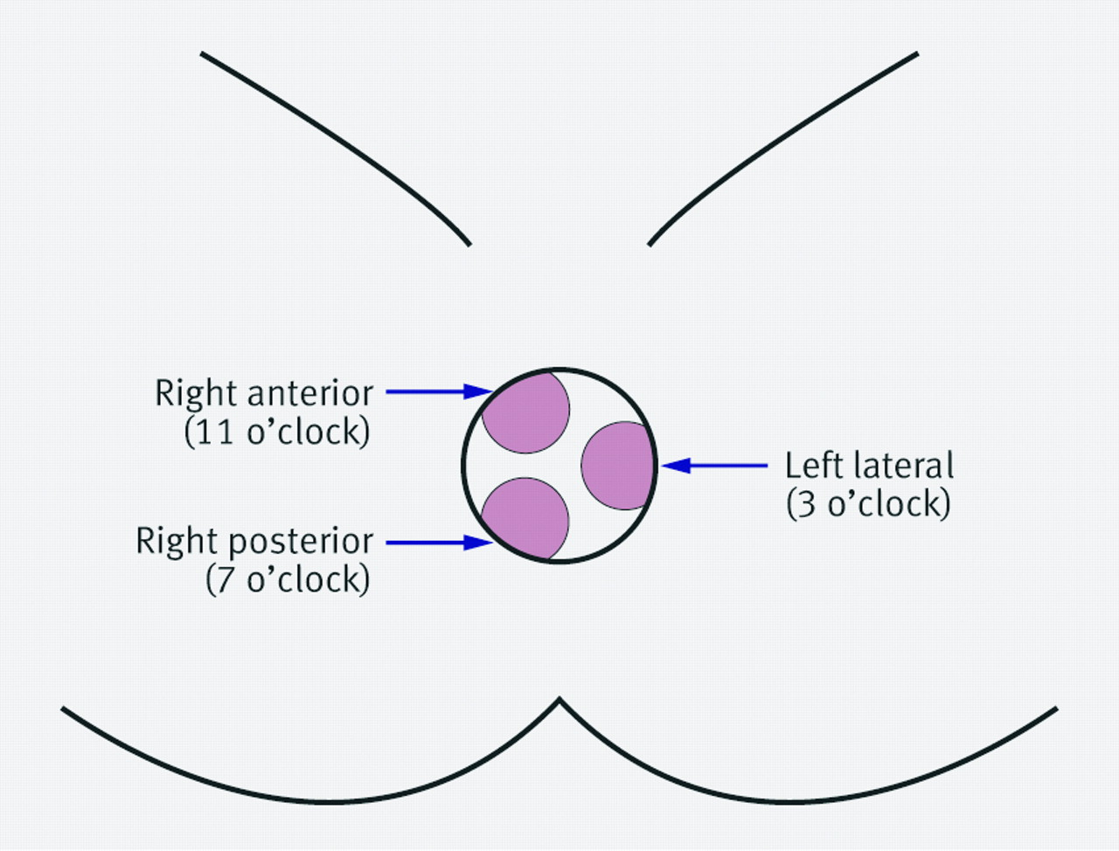
Positions of Primary Internal Haemorrhoids

Slide 18
Grades of Haemorrhoids
Degree of Piles :- I II III IV
Bleeding: + + + +
Prolapse: - + + +
Returns by itself : - + - -
Needs manual reduction: - - + -
Does not reduces: - - - +
even on manual reduction

Slide 19

Animation video showing grades of piles

Slide 20
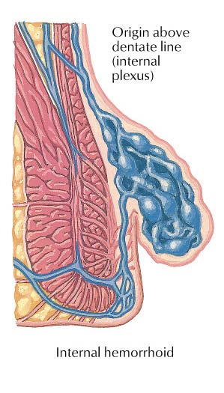
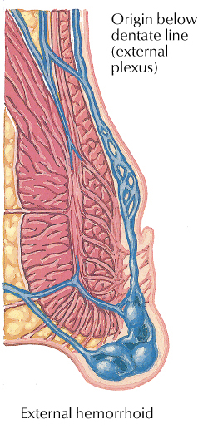
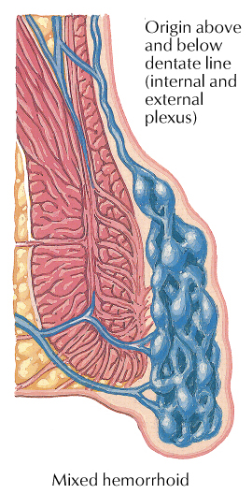
Types of Haemorrhoids

Slide 21
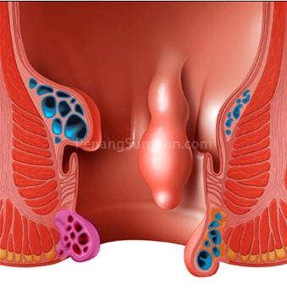
Symptoms of Haemorrhoids
1. Painless Bleeding during act of defecation
2. Swelling felt at anus due to prolapse
3. Painful Swelling at Anus in case of thrombosed external pile

Slide 22
Clinical examination of Anorectal region
Anal Region must be 1st inspected,
        2nd palpated,
        3rd digitally assessed,
        4th seen using anoscope.
(Note of caution : We may miss an important finding, if we omit any of the above step during P/R examination)
Clinical Diagnosis will be reliable only after all the above steps of examination are done methodically.

Slide 23
Examination of Anorectal region
1. Fingers – can palpate above anorectal line
(8 cms from anal verge)
2. Proctoscope – can inspect anal canal, anorectal ring
& lower 3rd of rectum (10 cms from anal verge)
3. Sigmoidoscope – can inspect last 25 cms of Colon

Slide 24
Treatment Modalities for Haemorrhoids
As per the degree of Piles, various modalities of surgical management :
Degree of Piles Treatment Modalities
Iº & IIº 1. WASH regimen (conservative)
2. Sclerotherapy
3. Rubber Band Ligation
4. Infra Red Coagulation (IRC)
5. Laser Ablation (Haemorrhoidoplasty)
6. Ultroid Technology (Haemorrhoidolysis)
_____________________________________________________________
IIIº & IVº 1. Open Haemorrhoidectomy
(Milligan Morgan Method)
2. Closed Haemorrhoidectomy
(Hill Ferguson Method)
3. MIPH/PPH (Haemorrhoidopexy)
4. DG-HAL (Haemorrhoidal Artery Ligation)
5. Harmonic Scalpel Haemorrhoidectomy

Slide 25
ULTROID Technology
(Lunch Break Procedure)
Direct current via dual tipped disposable needle probe (negative electrode)
Probe tip is placed on (but not inserted into) uppermost portion of haemorrhoid in longitudinal axis of vessel at a slightly angle to the anal canal
Direct current is given in milliamp for maximum of 10 minutes to each pile
Follow up is advised after 14 days as physiological disappearance of piles through cell breakdown & gas exchange takes place in 2 weeks
Completion of treatment: On anoscopy, no residual haemorrhoids seen & resolution of all symptoms.

Slide 26
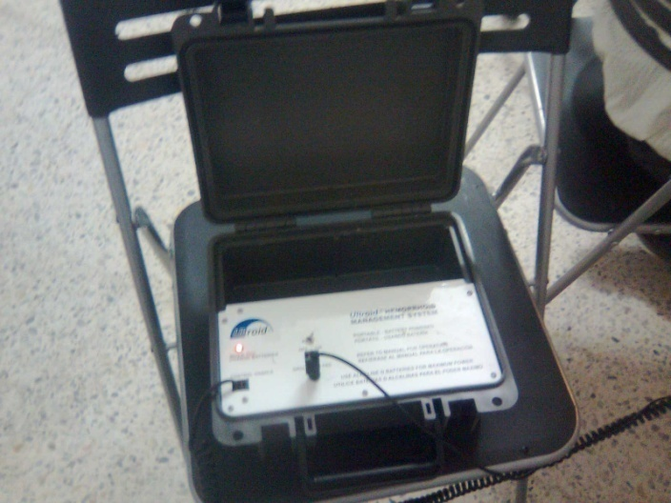
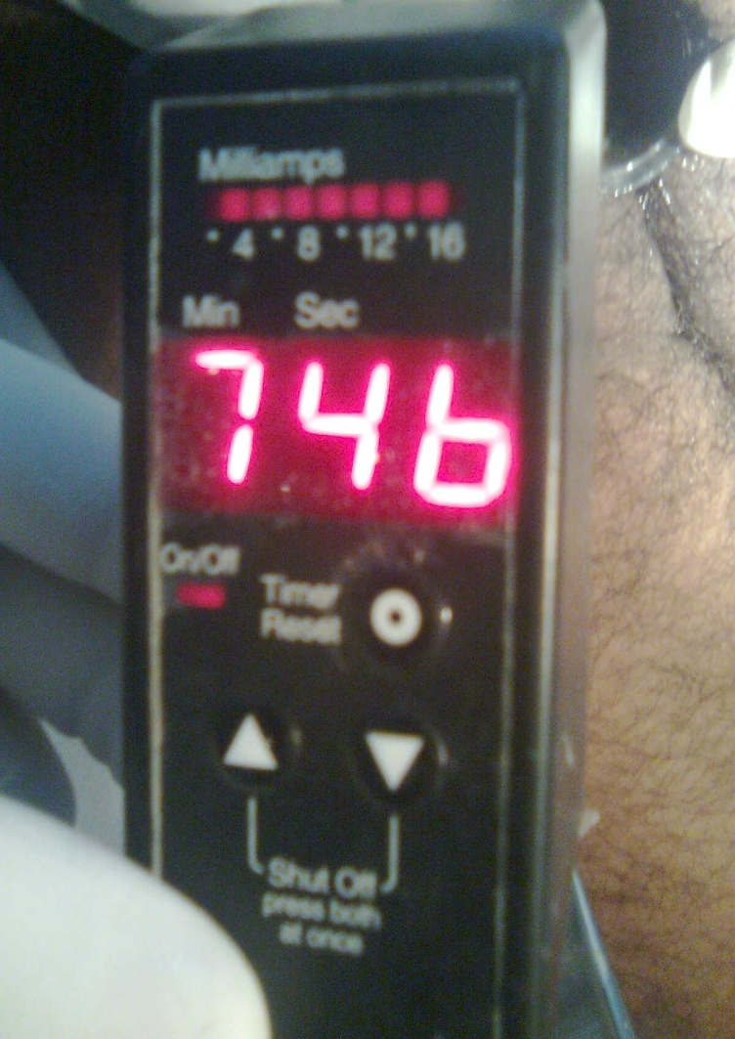
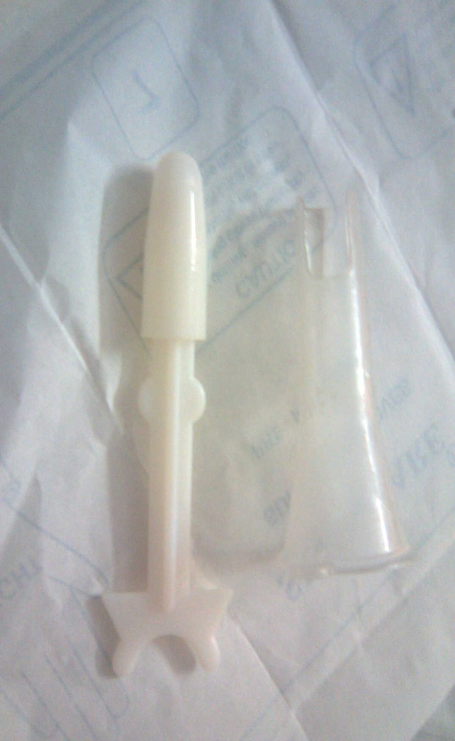
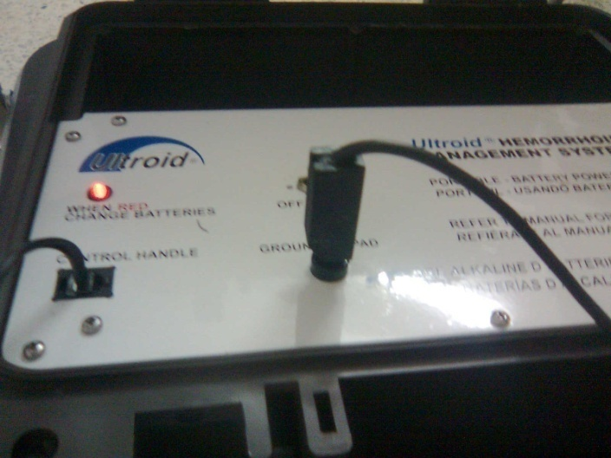
ULTROID Instrument

Slide 27
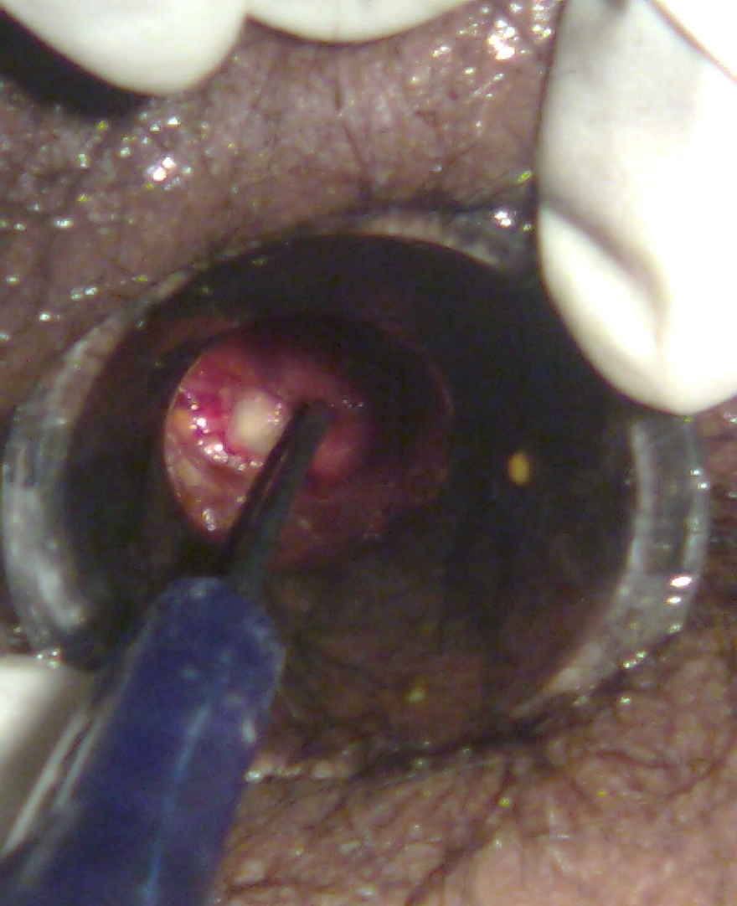
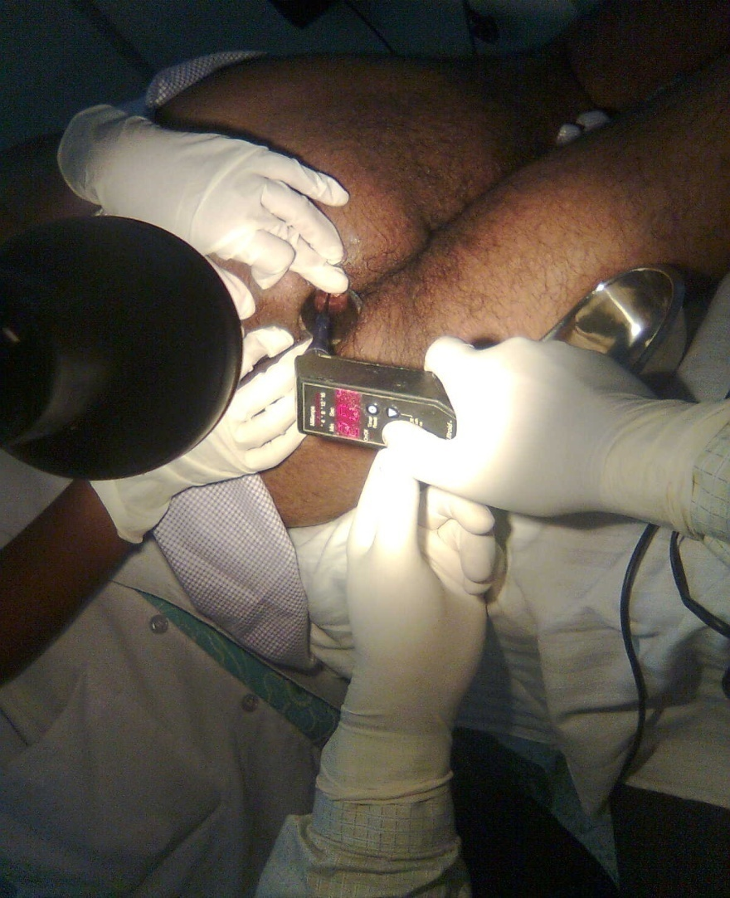
ULTROID in Action

Slide 28
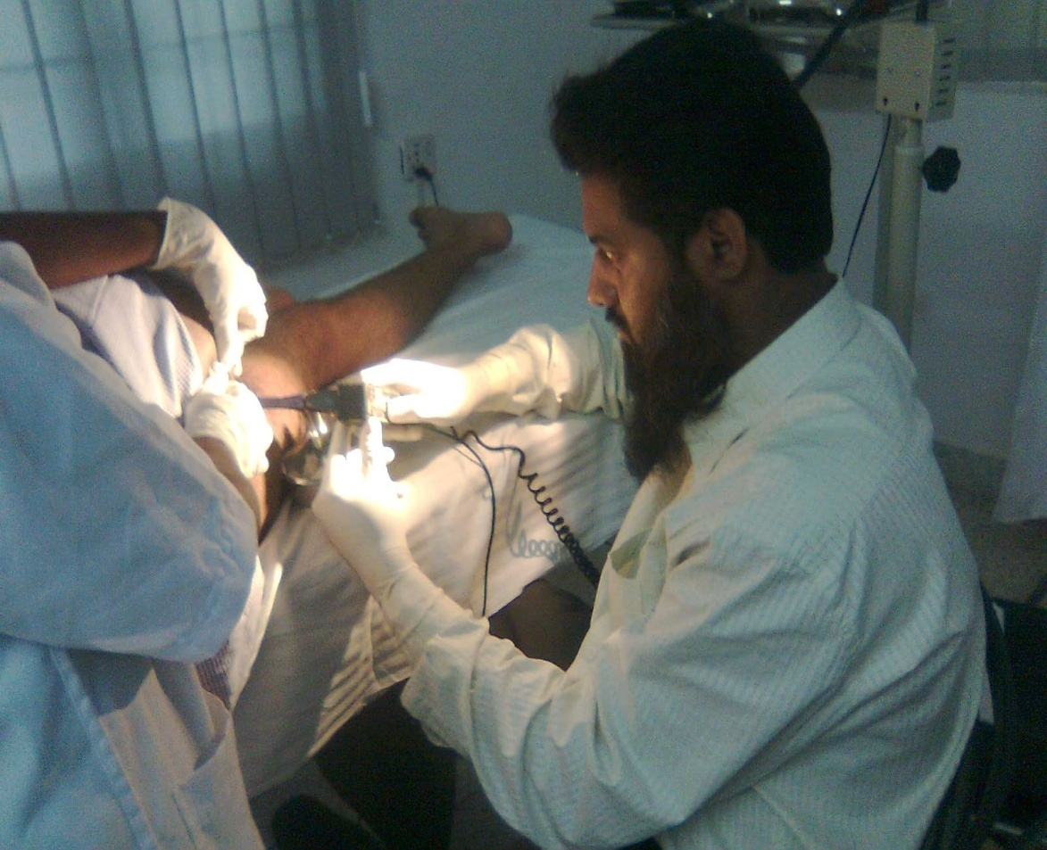
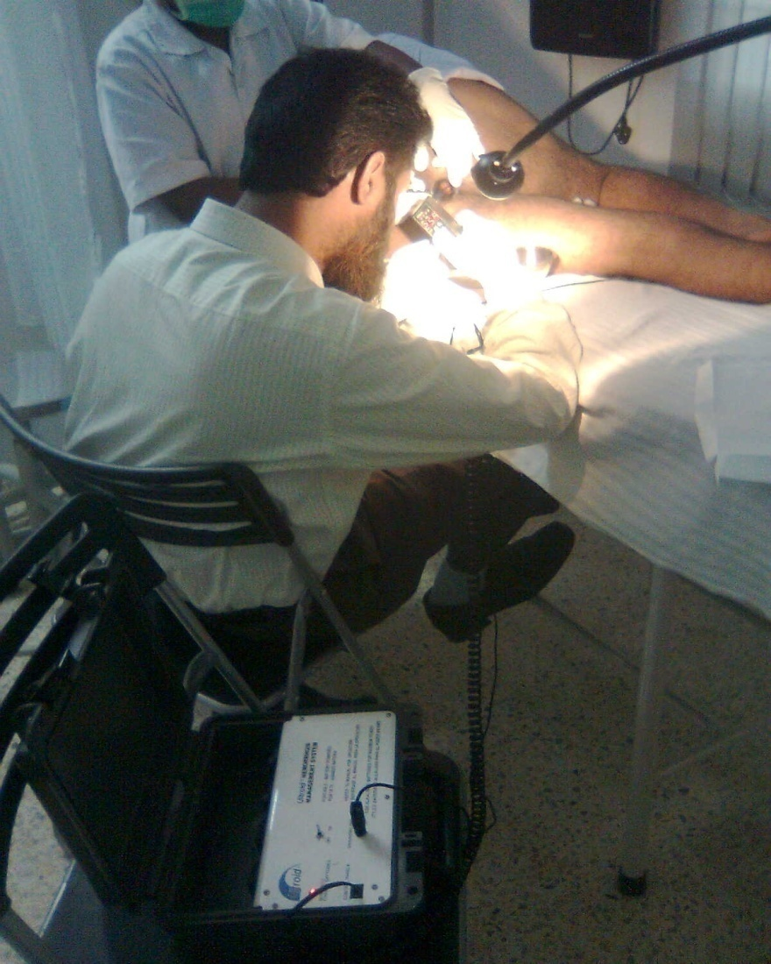
Office Procedure (OPD procedure)

Slide 29
Doppler Guided Transanal Hemorrhoidal Ligation (DG-HAL & RAR)
New Technique introduced in Europe in 2000
Hemorrhoidal Artery Ligation is a minimal invasive daycare procedure.
The Doppler detects the haemorrhoidal arteries (moving blood).
All arteries within dept of 7mm from mucosal surface are being ligated through a ligation window using 2-0 vicryl suture on 5/8 round body needle,
By ligation the blood flow to the hemorrhoids is interrupted & they start to shrink immediately.

Slide 30
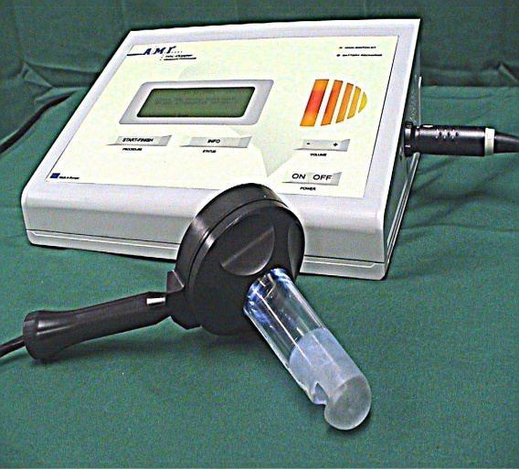
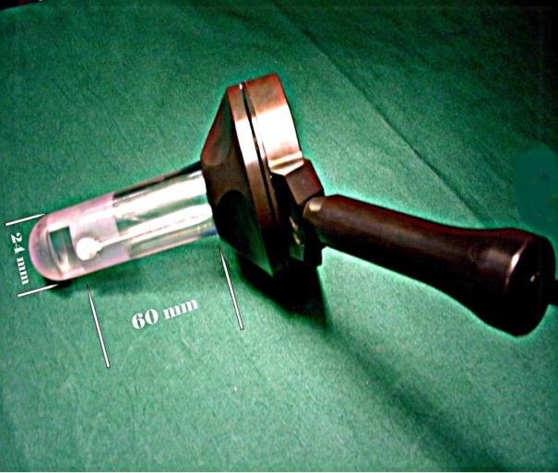
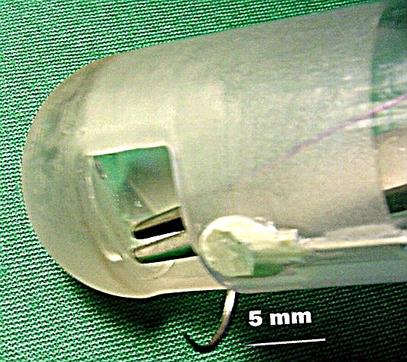
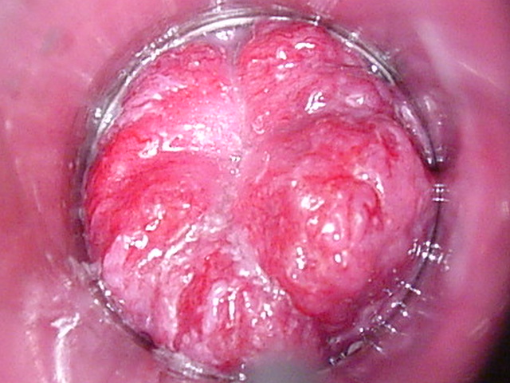
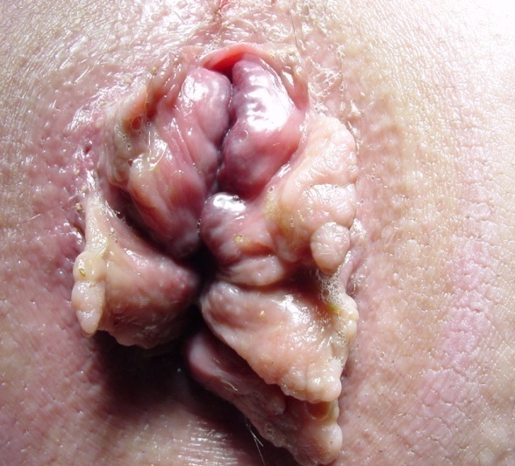
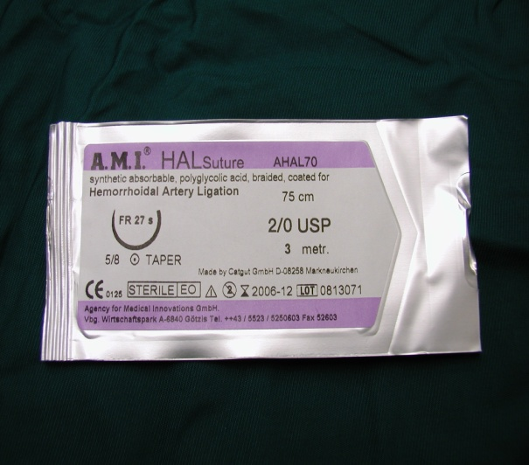
Haemorrhoidal Artery Ligation Tools

Slide 31
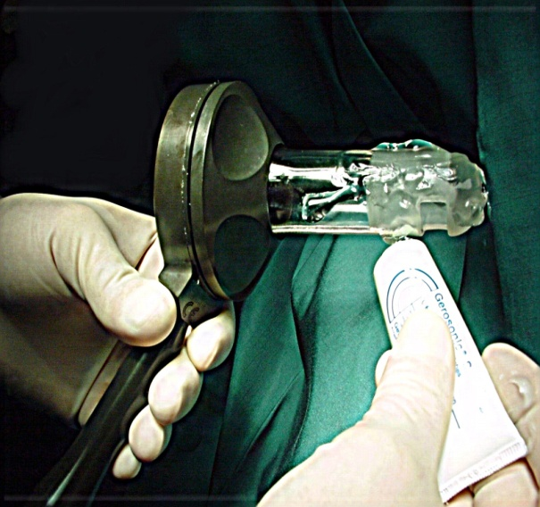
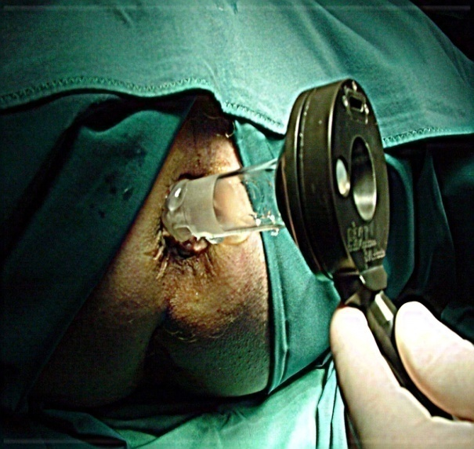
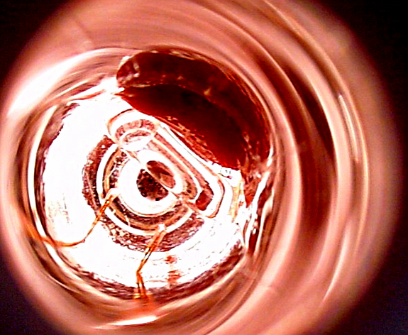
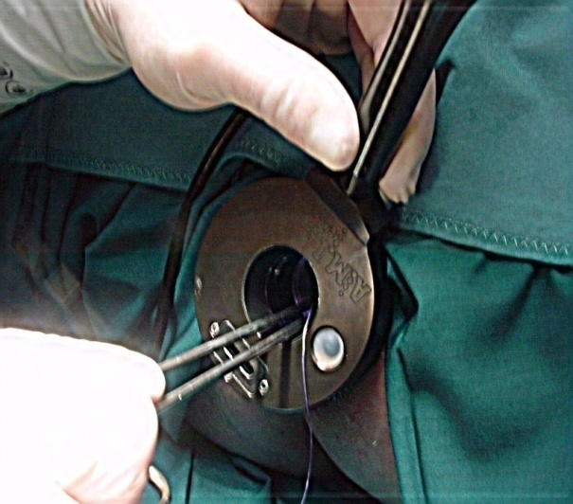
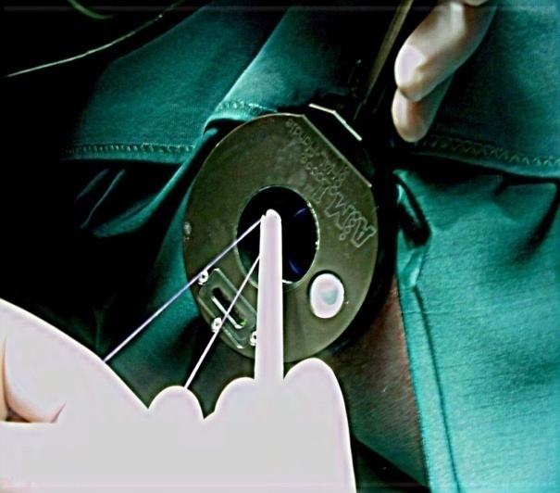
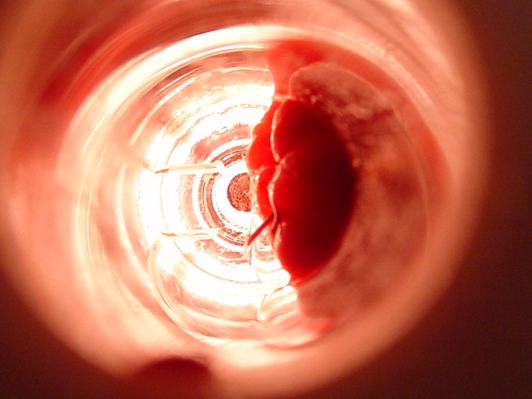
HAL Procedure

Slide 32
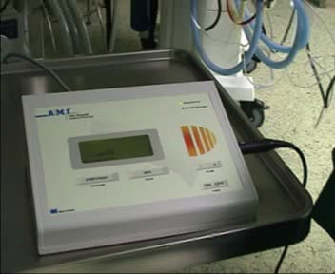
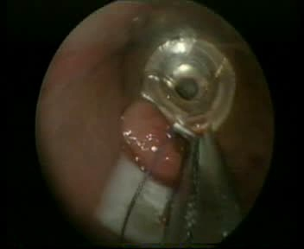
Doppler Machine & Operating Proctoscope

Slide 33
RAR – Rectoanal Repair
Rectoanal Repair (RAR) is the 2nd step of HAL procedure where the prolapsing tissue is pulled up & fixed by sutures called as Mucopexy.
Step I: Hemorrhoidal Artery Ligation (HAL)
Step II : Mucosa lifting & Fixing it high (RAR)
(Note : Step 2 is indicated only if the Piles are prolapsing outside – Gr II, III & IV)

Slide 34
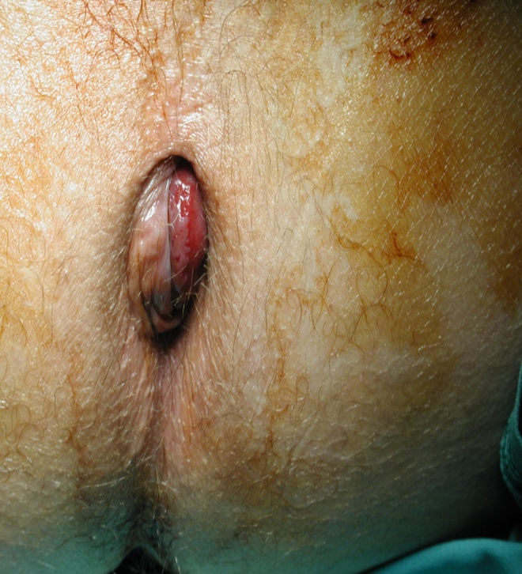
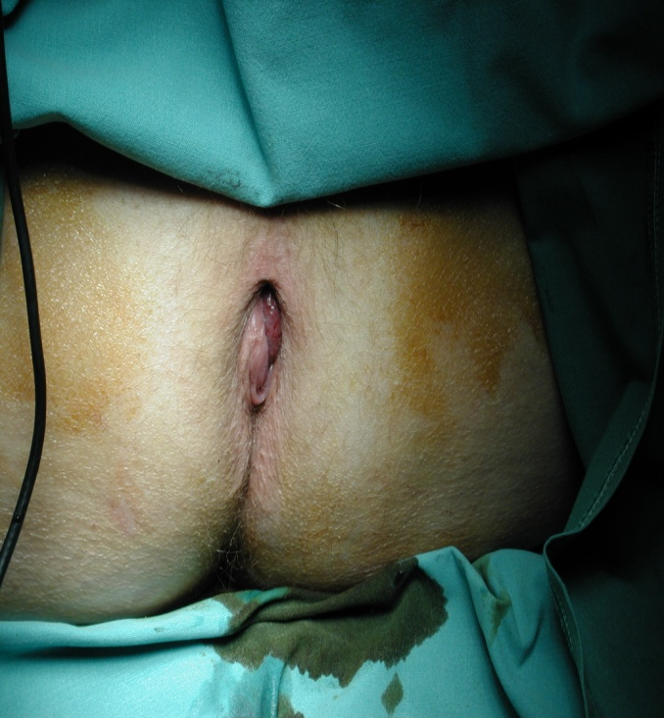
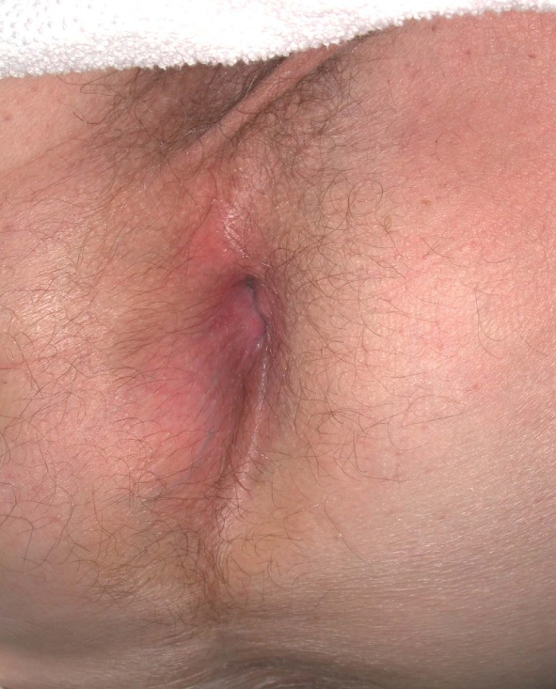
Result of Grade III & IV Hemorrhoid by DG-HAL/RAR Procedure

Slide 35
Videos for HAL & RAR technique

Slide 36
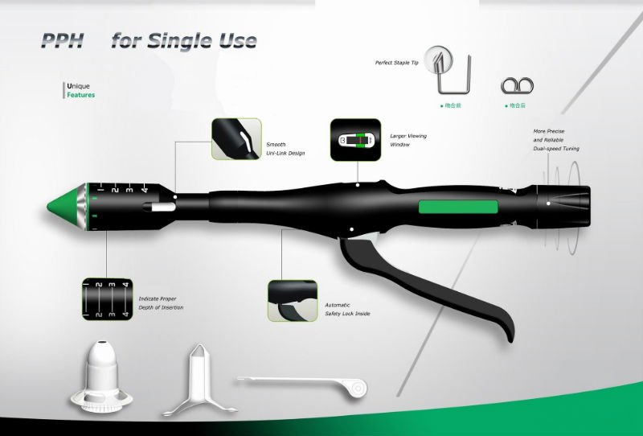
Haemorrhoidopexy using Staplers

Slide 37
MIPH / PPH
It is a Stapled Transanal Mucosectomy
MIPH – Minimally Invasive procedure for Haemorrhoids,
PPH – Procedure for Prolapse & Haemorrhoids
Ideal procedure for Circumferential Haemorrhoids & Multiple Piles of varying grades.
Invented by Dr. Antonio Longo, an Italian Surgeon in 1993 but was introduced for use in 2003.

Slide 38
Peri Anal Haematoma
Often incorrectly termed as - “Thrombosed External Pile”
It is a small haematoma due to rupture of anal venule.
It caused due to pressure on the plexus of Inferior Rectal veins.
Appears suddenly and is very painful.
On Examination, it seen as bluish fixed swelling at lateral region of anus.
If Untreated, it may resolve, suppurate, fibrose to form a skin tag, burst to bleed.
In majority cases, it resolves itself. Therefore, Milligan calls this condition as
‘A 5-Day, painful, self-curing Lesion’.
Rx – External Haemorrhoidectomy

Slide 39
Complications of Haemorrhoidectomy
1. Post Operative Pain
2. Haemorrhage – Primary (within 24-36 hrs)
  - Secondary (5th-10th post op day)
  3. Urinary Retention (Early complication)
  4. Anal stricture / Stenosis in 3-6% patients (late)
  Note : Most of the above complications can be
  prevent by using new minimal invasive modalities.

Slide 40
Animated video for Laser Haemorrhoidoplasty

Slide 41
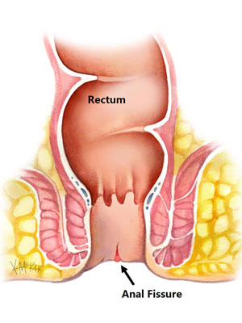
ANAL FISSURE

Slide 42

Fissure in Ano
Definition:-
It is a superficial split in anoderm extending from distal to dentate line to anal verge.
OR
It is a linear ulcer in squamous epithelium of anal canal located between the dentate line and anal verge.

Slide 43
Classification of Fissure in Ano
Acute Fissure in Ano :-
Superficial ulcer over IAS of less than 6 weeks duration.
Chronic Fissure in Ano :-
Fissure with secondary changes like
- sentinel pile (skin tag),
- hypertrophied anal papilla,
- induration of lateral edges of fissure of more than 6 weeks duration.

Slide 44

Acute / Chronic Fissure in Ano

Slide 45
Aetiology of Fissure in Ano
Spasm of Internal Anal Sphincter (IAS)
Pathophysiology
Due to pain in anal fissure
Patient tries to avoid defecation
Causing more hardening of stools
Results in further tear of anoderm during defecation

Slide 46
Site of Fissure in Ano
Ulcer rests directly over Internal Anal Sphincter (IAS) & its circular fibers are visible on the floor of fissure on inspection
90% occurs in Posterior midline (6 O’clock Position) – Primary site
10% occurs in Anterior midline (12 O’clock position) – Secondary site

Slide 47

Diagnosis of Fissure in Ano
History :
1) Anal pain during & after defecation, lasts for 12 hrs
2) Bleeding P/R – bright Red
Examination : It is done in the following sequence :-
a) Inspection
b) Palpation
c) Per rectal Digital evaluation :-
to assess sphincter spasm
d) Proctoscopy :-
to rule out other causes of anal pain

Slide 48
Examination findings in Anal Fissures
Acute Fissure – anal spasm does not allow for digital evaluation
Chronic Fissure – 3 features of chronic Anal Fissure :-
i) Fissure with sentinel tag at distal end,
ii) Fissure with hypertrophied anal papilla at proximal end,
iii) Appearance of circular fibers of IAS muscle in its base.
(Note: Either all 3 or any 1 of the above features can be seen to confirm CHRONIC fissure)

Slide 49



Chronic Anal Fissure :-
i) Sentinel Pile
ii) Anal Papillae
iii) Internal Sphincter exposed

Slide 50




Signs
&
Symptoms

Slide 51
Differential Diagnosis in Anal Fissure
If anal fissure not found in midline,
Or seen in secondary sites,
Or are multiple in number,
Or is painless.
Then the following conditions should be suspected:-
Crohn’s disease
Ulcerative Colitis
Trauma
HIV (seropositive)
Tuberculosis
Syphilis
Neoplasia – Leukemia / Carcinoma

Slide 52
Management of Fissure in Ano
There are 4 modalities of treatment :
Conservative – “WASH” Regimen,
Medical Therapy :
i) Topical Glyceryl Trinitrate (GTN) – vasodilator & smooth muscle relaxant (Rectogesic 0.4% ointment t.i.d.) for 8 weeks gives relief for 2 to 6 hrs.
ii) Diltiazem ointment 2% (Ca channel blocker) for 6-8 weeks
If medical therapy fails, then opt for Inj. Botulinum toxin
20-25u in 2 divided doses (0.2ml) – it induces hypotonia & reduces resting pressure in anal canal. It should be given once in a month for 2 months
It is injected on either side of the anal fissure into the IAS.
Surgical Options :- Indicated if ulcer does not heal after 8 weeks of medical therapy.
i) Anal Dilatation (obsolete) iii) Lateral Sphincterotomy
ii) Fissurectomy (chronic) iv) Anal Advancement Flap

Slide 53
W.A.S.H. Regimen
W – Warm Sitz bath (10 mins) x 2-3 times/day
A – Analgesic (oral & topical application)
S – Stool softener (osmotic laxatives)
H – High Fibre diet (life long)
Recurrence is 30-70% if high fibre diet is discontinued.
(Note: For painful spasmodic anorectal conditions, do not use Bulk laxatives, instead use Stimulant laxatives)

Slide 54


Lateral Internal Sphincterotomy

Slide 55

Chemical Sphincterotomy (Inj Botox)
20 units of Inj Botox are
injected in intersphincteric
plane at 12, 3, 6, 9 o’clock
Site (circumferentially).
Action begins after 48 hours.
Effect lasts for 3 months.
Contraindication : Perianal eczema or local sepsis

Slide 56

My original Article published on Chemical Sphincterotomy

Slide 57

Anal Advancement Flap
Indicated for chronic
anal fissure without
anal spasm.

Slide 58
“IDEAL” recommendations for treating Anal Fissures
High rectal resting Pressure (anal spasm present):
Acute Fissure :- Chemical Sphincterotomy using Inj Botox (OPD procedure)
Chronic Fissure with sentinel pile/papilloma :- Fissurectomy + Excision of Sentinel pile + lateral sphincterotomy
Low rectal resting pressure (No anal spasm):
i) Fissurectomy with Anal Advancement Flap

Slide 59
Recurrence Fissure in Ano
Causes of Recurrence:-
Discontinuation of High fibre diet,
Other pathological disease like TB, UC, CD or Malignancy etc (Needs thorough evaluation),
Incomplete Sphincterotomy.
Management:-
Put the patient again on conservative Rx,
Complete the sphincterotomy on the previous site / do a 2nd sphincterotomy on the opposite side.

Slide 60
Fissure with associated Anal Conditions
Fissure + Iº IIº Piles – Lateral Sphincterotomy + Ultroid or Laser,
Fissure + IIIº Piles – Lateral Sphincterotomy + HAL/RAR,
Fissure + Anal Stenosis - Lateral Sphincterotomy
along with Anoplasty / Advancement Flap,
Fissure in Homosexual – Fissurectomy + Culture with Histopathology of excised fissure specimen

Slide 61


Slide 62

FISTULA IN ANO

Slide 63

Fistula in Ano
Definition :
It is a track lined by granulation tissue which connects lumen of anal canal / rectum to the skin around the anus.

Slide 64

Etiology of Fistula in Ano
Repeated infection of Anal gland called as Cryptoglandular infection - 95% (Anorectal Abscess)
Extension of cutaneous Boil (Folliculitis)
Penetration of rectal wall due to trauma
Crohn’s Disease
Diabetes
AIDS
Common organisms :
E. Coli (90%)
Enterococcus species
Bacteroides species

Slide 65

Types of Anorectal Abscess

Slide 66
Classification of Anorectal Abscess
Perianal 60% - suppuration in anal gland
in subcutaneous portion of external sphincter.
Managed by I&D – cruciate incision & deroofing.
2. Ischiorectal Abscess 30% - lateral extension of anal abscess.
It communicates with opposite side via postsphincteric space forming a “Horshoe” shaped abscess enveloping the posterior part of circumference of anal canal.
3. Submucous Abscess 5% - occurs above dentate line.

Slide 67
Classification of Anorectal Abscess
4. Pelvirectal abscess – situated between levator ani & peritoneum.
Cause:- It is a pelvic abscess secondary to
i) Appendicitis,
ii) Salphingitis,
iii) Diverticulitis,
iv) Crohn’s Disease
5. Fissure Abscess – It’s a subcutaneous abscess in association with anal fissure.
Drainage can be done along with sphincterotomy.

Slide 68

Classification of Anorectal Abscess
As per site of location in different tissue spaces
Perianal 60%
Ischiorectal 30%
Intersphincteric 5%
Supralevator 5%

Slide 69
Types of Anal Fistulae
Anal fistulae are broadly classified depending on the level of internal opening:
LOW Level HIGH Level
Fistulous opening into 1. Fistulous opening
anal canal BELOW into anal canal
Anorectal ring ABOVE Anorectal ring
Can be drained without 2. Managed by staged
risk of Incontinence operations with
colostomy.

Slide 70


LOW Level Anal Fistula HIGH Level
Low Intersphinteric 1. High
Low Transphincteric 2. High
Subcutaneous 3. Pelvirectal
Submucous 4. Supralevator

Slide 71


Slide 72

Goodsall’s Rule
Fistulae with external opening in anterior half of anus has direct track.
Fistulae with external openings in posterior half of anus have curve track.
Fistulae with multiple external openings in posterior half of anus always open into a midline solitary internal opening by a straight track.
Exception to this rule :- Anterior external opening which is >3cms away from anus can have a curved tract and opens posteriorly.

Slide 73
Clinical examination for Anal Fistula
Digital Rectal examination (DRE)
Internal opening can be felt as a nodule on the wall of anal canal.
Irrespective of number of external fistulous openings, there is always a single internal opening.
2. Proctoscopy – Hypertrophied papillae can be seen as internal orifice lies within crypt of the papillae.

Slide 74
Clinical Types of Fistula in Ano
Fistula with Anal fissure
Multiple fistulae secondary to :
- Tuberculosis (No induration with watery discharge)
- Crohn’s Disease.
3. Hidradenitis Suppuritiva – Chronic infection of apocrine glands around anal margin causes multiple sinuses.
4. Carcinoma arising within perianal fistulae.
Note : Adenocarcinoma & Squamous cell carcinoma are known to arise within chronic fistulous track.
(Therefore all tracts excised should be sent for HPE)

Slide 75
Radiological Investigations in Anal Fistulae
[MRI or Endo Anal Ultrasonography]
Uses:-
1. To map complex fistulae,
2. Information about anatomy, multiple tracts & occult abscess.
Indications:-
1. Role in only deep seated (Supralevator/Intersphincteric),
2. Multiple recurrent poorly drained abscess,
3. Patient is symptomatic but internal opening not seen.
Fistulography NOT useful.

Slide 76



Endo Anal USG

Slide 77
Operations for Low level Fistula
Fistulotomy (opening the tract)
II) Fistulectomy (excising the tract):-
Coring the tract from external opening till internal opening,
New Instrument is introduced called as Fixcision to core the complete tract.

Slide 78

Coring of Fistula Tract
It is a sphincter saving procedure.
Core out fistulectomy - combines anal sphincter reconstruction & primary repair of internal opening by “Fish Eye Technique”.
Short period of daily wound dressings are mandatory.

Slide 79
Operations for High Level Fistula
If tract is laid open, incontinence will follow.
High Level tracts often require staged operation,
Conservative fistulectomy
(with reconstruction of sphincter)
2. Fistulectomy with use of seton
3. Fistulectomy with colostomy

Slide 80
Division of the Sphincter
Internal & External Sphincter division below pectinate line is safe - No Significant Incontinence
Division of Entire Internal & External sphincter - Temporary Incontinence
Complete division of puborectalis - Gross Incontinence

Slide 81
Repair of The Sphincter
Primary repair of sphincter – after eradication of pathology.
Iatrogenic injury should be identified on table and repaired primarily.
Secondary repair - as soon as possible

Slide 82
Post Operative Management
Prevent bowel movement for atleast 24 hrs.
Wound irrigations & Apply Metrogyl Gel.
Dress after every bowel movement or twice a day for atleast 1 week.
Flush any embedded fecal matter.
Wound inspection by the Surgeon at regular follow up visits till it heals.

Slide 83
Complications in Fistula Operation
1) Recurrence:
-Missed secondary / Supralevator tracts,
-Internal opening not closed properly,
-Residual infected gland,
-Tuberculosis & Crohns Disease,
-Improper post operative management.
2) Incontinence: Iatrogenic in high level fistula tracts, also more in females with anterior tract.
3) Sepsis: Fournier’s Gangrene, Septicaemia

Slide 84
Recent Advances in Fistula Surgery
1) Video Assisted Anal Fistula Treatment (VAAFT) :
It is MEINEROS’ technique for Complex anal fistulas & Recurrent fistula.
This technique comprise 2 Phases :-
1) Diagnostic Phase
2) Operative Phase
Steps are Following :-
Correct localization of the internal opening under vision,
Fistula treatment from inside,
Hermetic closure of the internal opening using Stapler.
(Note: No prior radiological Imaging required)

Slide 85

Recent Advances in Fistula Surgery
2) FIXCISION - Minimally invasive technique for coring out fistula tract.
The Internal Opening is closed by Fish Eye Technique

Slide 86
Animation Videos for FIXcision

Slide 87
Real time video of FIXcision

Slide 88



Recent Advances in Fistula Surgery
3) Laser Ablation

Slide 89
Animation video for Laser use in Fistula

Slide 90

PILONIDAL SINUS
Sinus Abscess

Slide 91
Pilonidal Sinus
A pocket of infection that occurs in the tailbone area is called a "pilonidal" cyst or abscess
A pilonidal sinus is a subcutaneous sinus containing hair
Lined by granulation tissue rather than epithelium
Usually occur in the natal cleft
It is an Acquired condition and never congenital

Slide 92
Reason for its acquired aetiology
It appears in younger age 20 – 30 years
Hairy men are affected
It is also seen in hair dressers as interdigital pilonidal sinus in web of fingers
Hair follicle is never seen in the wall of pilonidal sinus
Hairs projecting from sinus are dead hairs
Recurrence is common

Slide 93

Sites of Pilonidal Sinus
Sacrococcygeal junction (most common)
Interdigital clefts of barber’s fingers
Interdigital web of foot in workers working in hair mattress factory
Umbilicus
Axilla

Slide 94
Pathogenesis
There are 5 stages:-
1. Hair follicle infection
2. Foreign body Granuloma / Foreign body reaction
3. Abscess formation
4. Sinus formation
4. Hair suction

Slide 95



Pathology

Slide 96

Clinical Presentation
Presents as recurrent pilonidal abscess (80%) which lead to recurrent discharging sinus (80%) in midline of sacrococcygeal region through which tuft of hairs can be seen in young males of 20-30 years age.
It is rare after the age of 40 years
Male : Female ratio is 4:1

Slide 97
Clinical Examination
Site – It has a typical position in midline at level of
1st piece of coccyx.
It is never seen between the tip of coccyx & anus
Sinus opening shows pouting out granulation tissue.
Sinus discharges serosanguinous, foul smelling sebum material & tips of free hair.
Cellulitis in sacrococcygeal area with induration due to ramifications

Slide 98
Classification
Simple Pilonidal Sinus : This is a central sinus with small cavity, having minimal secondary tracts, closer to midline.
Complex Pilonidal Sinus : This has branching tracts away from the midline, frequently it is a large tract and infected.
Pilonidal Abscess : Formation takes place whenever sinus opening gets blocked with infected contents

Slide 99




Clinical types of Pilonidal Sinus
Simple sinus Multiple sinus
Pilonidal Abscess Recurrence Sinus

Slide 100
Differential Diagnosis
Fistula in Ano – Don’t mistake a Pilonidal sinus for Perianal fistula
Osteomyelitis of Coccyx bone – Plain X ray of Coccyx bone may be advised if in doubt
Furunculosis
Tubercular granuloma (watercan perineum)
Syphilis
Actinomycosis

Slide 101

Differentiating points of Pilonidal sinus from Perianal fistula
In Pilonidal sinus, no induration is felt between the lowest sinus & anus.
In Pilonidal sinus, no fistulous opening found inside anus.
In Pilonidal sinus, on probing the lowest sinus, probe will pass towards sacrum & NOT anus.
Sinus Anus

Slide 102
Operative Management
Three types of management for chronic pilonidal sinus:
Excision and healing by secondary intention
- Lord’s procedure,
- Saucerisation,
- Marsupialization.
Excision and primary closure
- Midline closure with suction drain
- Lateral closure : i) Karydakis procedure
ii) Bascom’s procedure
3) Excision with reconstructive procedures (flap covers)

Slide 103

Rhomboid Flap

Slide 104
Surgical Principle in Pilonidal Sinus
Aims :-
1. Excise the complete sinus tract along with its ramifications
2. Prevent hair to grow into the wound as it heals
Word of caution :-
Important post operative care should be taken to prevent growth of new hair in granulation tissue.

Slide 105
Summary of Operative Rx for Pilonidal Sinus
Acute Pilonidal Sinus / Abscess: Incision & Drainage
Chronic Pilonidal Sinus:
1. Conservative management
2. Open methods – Lord’s procedure
Saucerisation
Marsupialization
3. Close methods - Excision & Closure :
i) Excision & Midline closures with suction drainage
ii) Excision & Lateral closures – Karydakis & Bascom
4. Recent Advances : Laser Ablation of sinus tract
Complex / Recurrent Pilonidal Sinus:
Reconstructive procedures - Z Plasty, V-Y advancement, Rhomboid flap, Gluteus maximus flap.

Slide 106

LASER Assisted Proctology (LAP)

Slide 107
LASER in Proctology
Diode laser (980/1470nm) from LASOTRONICS Company, Polland.
More the wave length of laser used, deeper the penetration (For eg: 1470 used for varicose veins)
It is user friendly & compatible for both Endovascular Laser Ablation in Varicose veins and Proctology.
Benefits of diode laser (DL) :
- It penetrates upto 2mm & thereby causes less thermal damage to surrounding tissue.
- It can also be used in patients with Coagulation Disorders.

Slide 108
LASER Fibers
There are 2 types of laser fibers used in Proctology :
Bare tip (linear emission) – Used in Haemorrhoids & Excision of Skin tags
ii) Radial tip (circumferential emission) – Used for Ablation of Fistula tract & Pilonidal sinus tract

Slide 109

Laser Fibers
Radial
Bare

Slide 110
1. Laser for Haemorrhoids
Name of procedure:
LASER HAEMORRHOIDAL PLASTY (LHP)
Indication : Small / Medium sized piles (Gr I, II & III)
Mode of Action : Laser tip inserted at submucosal plane & energy delivered.
Tissue retracts around the veins & hypertrophic haemorrhoidal tissue is denaturised submucosally resulting in proper resolution & shrinkage of pile mass.
LHP reduces haemorrhoidal tissue, it does not excise/destroys it.
It takes 2 – 4 weeks to get complete shrinkage of pile mass

Slide 111
2. Laser Sphincterotomy
It is a closed type of lateral sphincterotomy done in internal sphincters using bare fiber tip.
Method : Raise of wheal of mucosa by local infiltration of Inj Xylocaine + Inj Adrenaline at muco cutaneous junction,
Enter submucosal plane to cut the internal sphincters only 5mm from medial to lateral direction (heat energy should not be given >100 joules per procedure)

Slide 112
3. Laser Ablation for Fistula in Ano
Procedure done for anal fistula is termed as Distal Laser Proximal Ligation (DLPL).
It is unlike Modified FiLAC procedure, where internal opening is not closed.
It is similar to LIFT (ligation of intersphincteric tract), where the tract is dissected near internal opening & divided between ligatures and distal part of tract is ablated by radial fiber of laser
Indications:
1) Low level Intersphincteric Fistula
2) Low level Transphincteric Fistula

Slide 113
4.Laser Ablation of Pilonidal sinus tract
Method : Sinus opening is widened to insert the scoop/curette and all dead hair along with debris is removed. The tract is irrigated to clean.
Radial Fiber is inserted inside the sinus tract and energy deployed to ablate the tract completely at 10 watts & with pull back of 100 Joules/cm
Results are promising…

Slide 114
Video Clips of LASER
Laser for Fistula tract ablation
Laser for ablation of Pilonidal Sinus
Laser for Sphincterotomy – closed & open
Laser for Haemorrhoids

Slide 115
Videoclip for laser in Pilonidal Sinus

Slide 116
Videoclip – Laser for Closed Sphincterotomy

Slide 117
Videoclip – Laser for Open Sphincterotomy

Slide 118
Videoclip – Laser for Haemorrhoids

Slide 119
Newer Trends in field of proctology in a Nutshell
Haemorrhoids :
DG-HAL/RAR
MIPH (staplers)
Laser (Grade I & II)
2) Fissure in Ano :
Chemical Sphincterotomy (Inj Botox)
Closed Internal Sphincterotomy using Laser
3) Fistula in Ano :
Fistulectomy (coring) using Fixcision
VAAFT
Laser Ablation of Tract (DLPL technique)
Pilonidal Sinus : Laser Ablation
[Note of Caution : LASER is not to be used in active infection]

Slide 120

Conclusion of using Newer technology in Anorectal surgery
Painless
Recurrence
Recurrence & Painless variables are inversely proportional to each other in using newer technology for anorectal surgery.

Slide 121
MAVEN MEDICAL CENTER
It is a stand alone daycare center for laser treatment in Proctology & Varicose veins
We have a team of 2 General Surgeons including one female surgeons & 2 Interventional Radiologists
Timings : 11AM till 5PM
Monday to Saturday
Location : Banjara Hills Rd No. 2, Opp New Rainbow Hospital, Hyderabad – 500034.
Website : www.mavenmedicalcenter.com

Slide 122
Thank You

